Slide 1
RADIO WORKS
Why radio is the best medium for D2C brands & e-commerce

Slide 2
Radio reaches more online shoppers than any social media platform
Radio vs. Digital Platform Reach
AM/FM Radio
Facebook
YouTube
83%
50%
40%
Instagram
Twitter
Video Sharing (Tik-Tok)
29%
15%
10%
Canadians who have shopped internet department/ warehouse stores in the past year – 7-day reach 18+
Source: RadioConnects, Numeris RTS Canada Spring 2022, A18+, / Total Canada shopped internet department/warehouse stores past year/*Media Mix Radio / TV / Daily Newspaper / Community Newspaper / Magazine / Internet

Slide 3
Radio drives traffic to online stores
+21%
lift in web activity for D2C brands*
On average, advertising on radio drives a +21% lift in site activity for direct-to-consumer brands
+92%
Additional direct online effect**
Research showed that radio drives up to 92% additional direct effect online
*Radio: LeadsRx study of 62 direct-to-consumer advertisers, link
**Measuring radio’s ability to drive web conversions – Talpa (NL), link

Slide 4
Radio drives
web traffic
+43%
Average brand web traffic lift
Campaigns with clear call-to-action to web/app generate on average
5x
more visits/GRP
Source: Radio to Web, Nielsen, TVTY, 2022, link

Slide 5
Radio delivers high effectiveness and efficiency
With only 10.2% share of advertising spendings, radio generated 27.8% share of website visits
Share of the media mix
Share of the media impact
Radio 10.2%
Radio 27.8%
Source: Drive2Web from radio campaigns: bynd on behalf of ARD, link

Slide 6
Radio drives
Google search
+29%
Lift in Google search activity*
52%
uplift
Exposed to all media except radio
Exposed to radio in addition to other media
Radio advertising boosts brand browsing by 52%**
*Radio Drives Search, RAB, Radio Monitors, link
** Radio: The Online Multiplier, Radiocentre UK, link

Slide 7
Radio is cost-effective and delivers high ROI
Radio is 4x more
cost-effective
at stimulating brand browsing than other media*
Radio ROI
1€
7.7€
Spend on radio
Generated on average**
* Radio: The Online Multiplier, Radiocentre UK, link
**Ekimetrics Survey 2021 - in 4 sectors : Automotive, Telco, PCG, Retail, link

Slide 8
D2C brands are increasing their ad spend on radio!
Direct-to-Consumer Brands’ Total Radio Spend (2021 vs. 2019)
1.7x
2x
2x
2x
Source: World Radio Alliance

Slide 9
The number of D2C brands that advertise on the radio is growing!
Number of DTC Brands active on Radio (2021 vs 2019)
+20%
+22%
x2.6
Source: World Radio Alliance

Slide 10
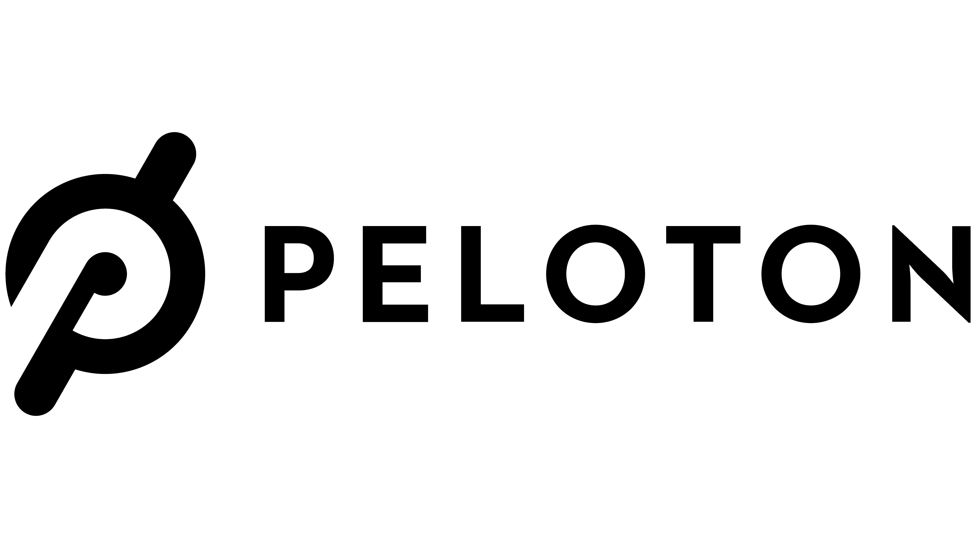
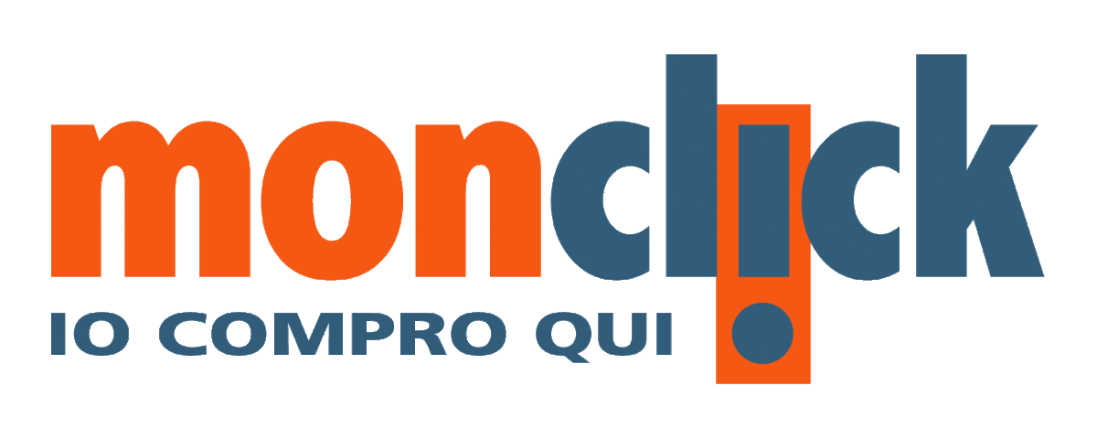
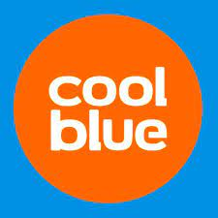
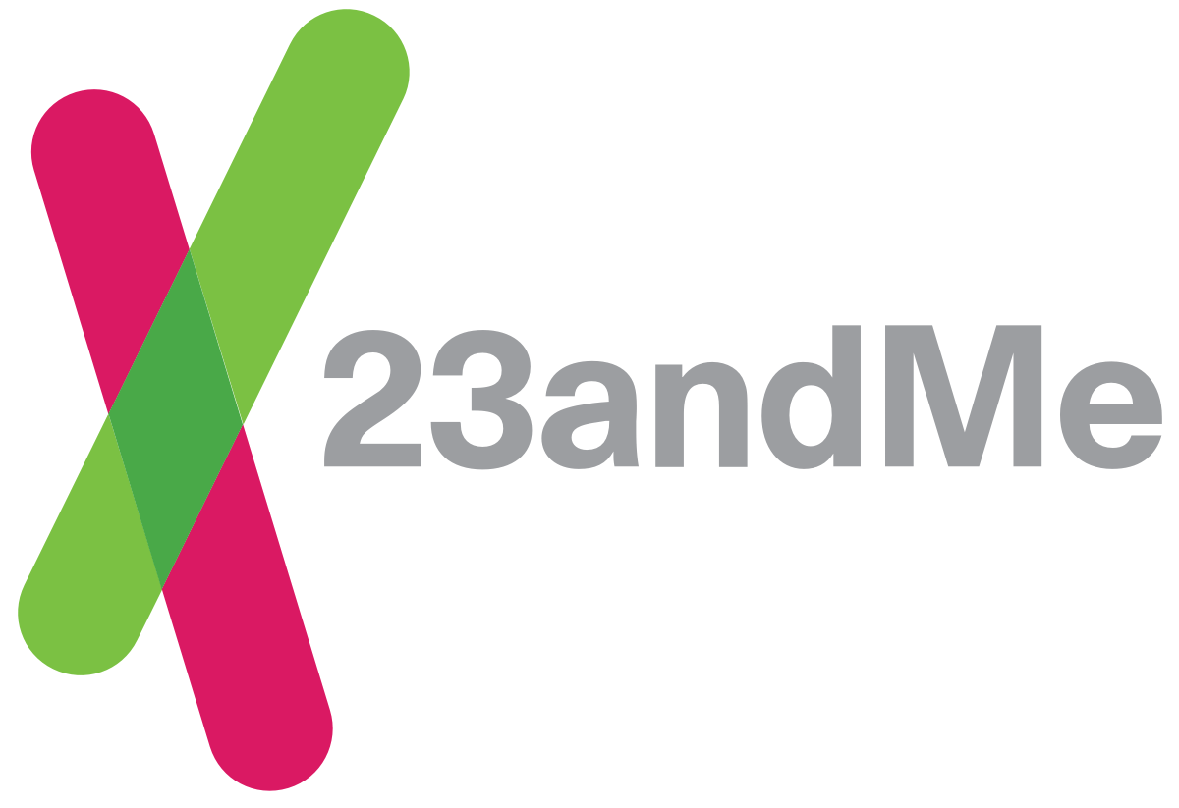
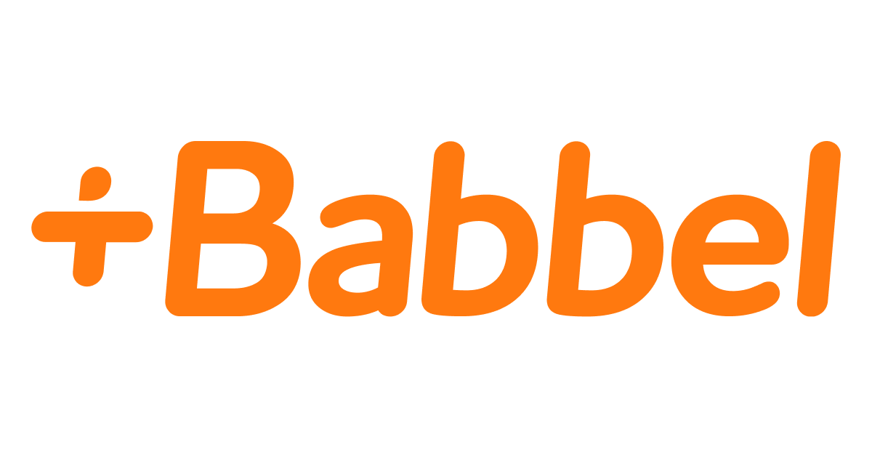
Join these top D2C radio spenders
Sample of top D2C spenders on radio from selected markets

Slide 11
RADIO with its ability to:
connect & engage with the audience
use its mass reach
drive search & site traffic effectively for a low cost
is the best medium to deliver messaging for D2C brands.
Notes:
Tune in to Success: Why radio is the best medium for D2C brands and e-commerce
The rise of DTC brands: How radio advertising is driving the direct-to-consumer revolution

Slide 12
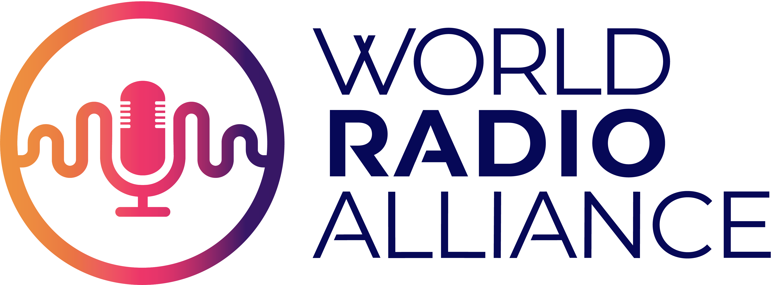
is a worldwide grouping of broadcasters’ and sales houses’ trade bodies across 16 markets, whose joint objective is to promote radio.
www.worldradioalliance.com
WRA on LinkedIn
WRA on Twitter

