Slide 1

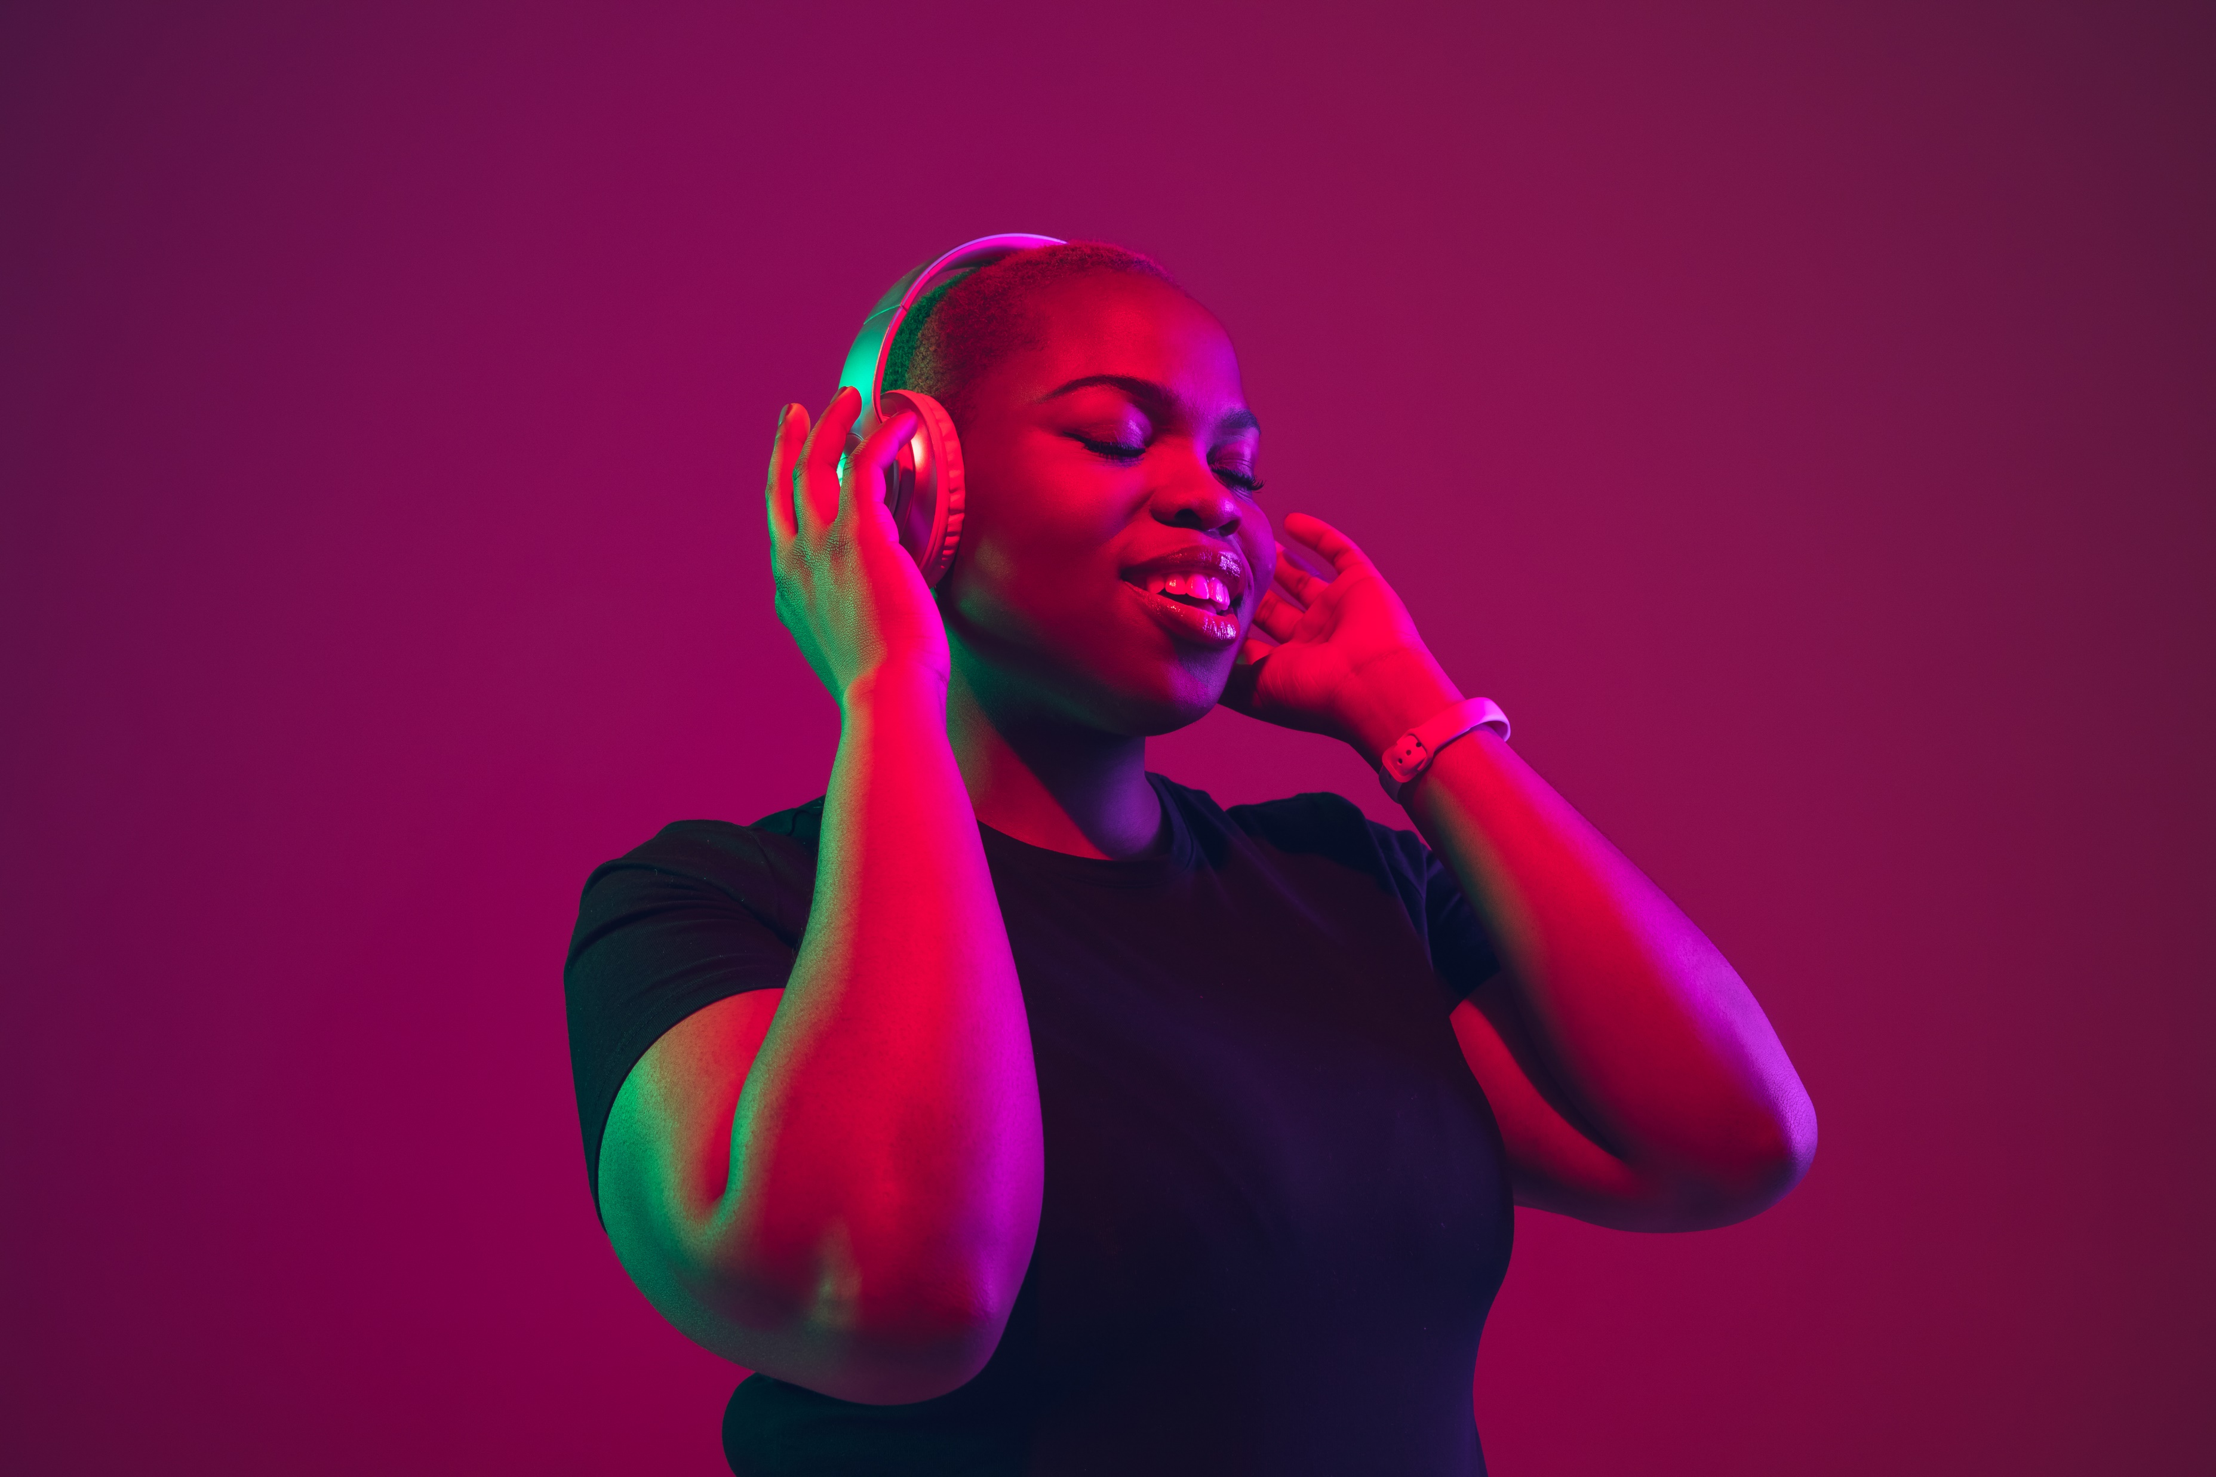
www.worldradioalliance.com
February 2023
10 things about Radio that may surprise brands

Slide 2




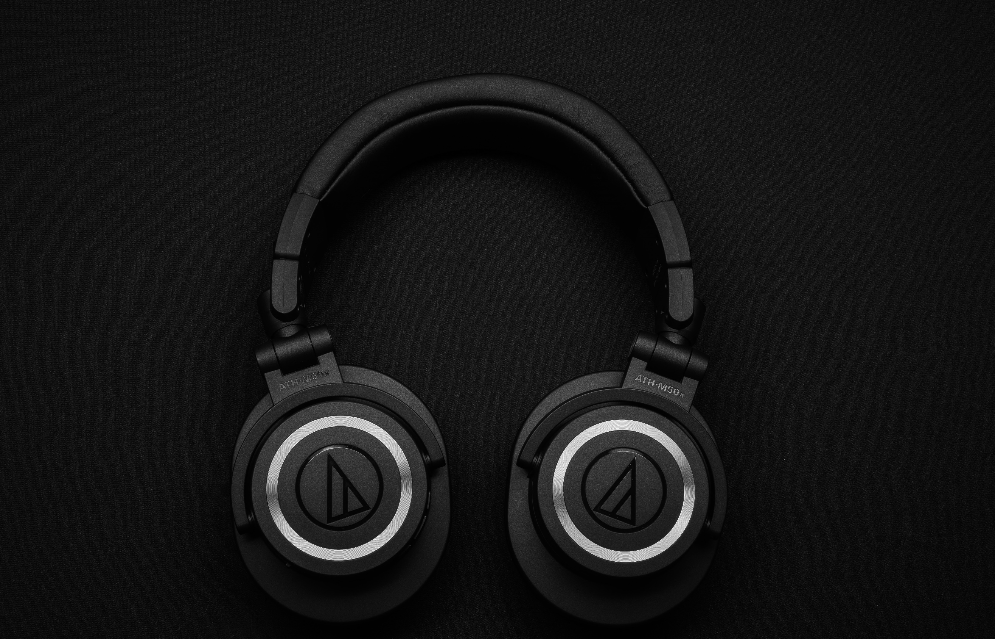

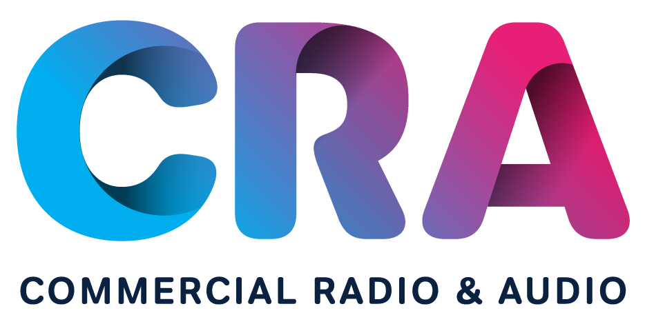


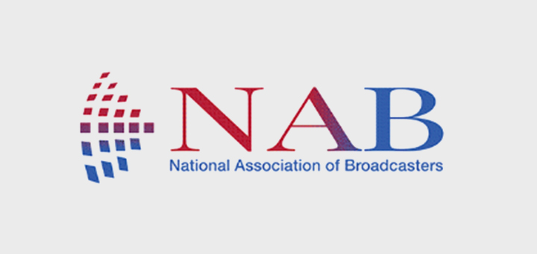







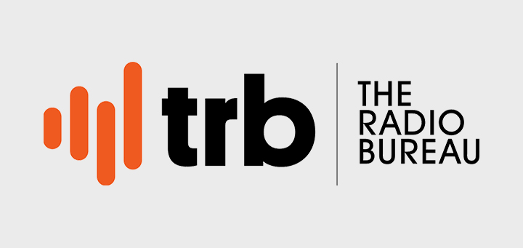


We, the World Radio Alliance,
want to challenge advertiser/ agency perceptions; not just about consumer media habits but also the role radio plays in helping brands flourish.
www.worldradioalliance.com
WRA is a worldwide grouping of broadcaster and sales house trade bodies from 16 markets, across 4 continents whose joint objective is to promote and demonstrate the power and value of radio in the media landscape.

Slide 3



1
Radio allows brands to reach millions of people on a daily basis
www.worldradioalliance.com

Slide 4

Strong reach & listening time
Radio allows brands to reach millions of potential consumers on a daily basis
Everyday, more than
70%
of the European population tune in to radio and listen
on average for
3 hours*
Reach is a strong media driver of sales effect, offering
22%
sales lift**
Sources: *egta Radio Focus 2022 // **Nielsen Catalina Solutions (500 advertising campaigns, US)
www.worldradioalliance.com

Slide 5


Strong reach & listening time
Radio is one of the leading media in terms of listening time
Germans spend
13.5 years
of their lives
listening to radio*
In Belgium, listening to radio is the
#1 media activity
in terms of time spent
After sleeping, it is the daily activity that takes up most of people’s time
(+/- 5 hours/day).**
Sources: Germany: *70 yrs of age with media use, minus 8h of sleep. Source: ma 2022 Audio II for radio total (incl. commercial-free programs) and TV, daily listening time Mon-Sun in minutes; Newspaper: ZMG Newspaper Qualities 2019/2022, 14; Online: ARD/ZDF online study Media Internet usage yesterday 2021, Mon-Sat, 14+. // Belgium: ** IP Life Time study
www.worldradioalliance.com

Slide 6

2
Radio dominates the booming audio landscape
www.worldradioalliance.com

Slide 7

Advertisers and agencies have a
disconnected perception of listening behaviour
… while radio dominates the ad-supported audio landscape
AM/FM radio’s share of listening is
3x greater
than what advertisers perceive and
19x larger
than ad-supported Spotify**
Sources: (U.S.) Perception: Advertisers Perceptions, 300 advertisers and agencies asked about audience perception (Aug 2022) & Reality: Nielsen Total Audience Report Q1 2022
www.worldradioalliance.com

Slide 8









Radio is bigger than any other platform
Listening levels dwarf tech platform usage
Radio listening levels dwarf tech platform daily usage levels*
Daily users
Any Radio
Sources: *(IR) JNLR (Oct 2021-Sept 2022)/Ipsos Social Network Tracker // **(NZ) The infinite dial New Zealand 2022 Edison Research, % listened audio source last week (18+)
www.worldradioalliance.com

Slide 9


Radio is the biggest part of
total audio listening
Radio is bigger than music streaming and podcasts put together and it is the only format that offers scale for brands to reach their consumers within the audio landscape
Share of Ear  Live Radio (AM/FM + DAB + Digital)  On-demand service/music  Podcasts  Others
Finland
Germany
Belgium
US
Ireland
Netherlands
Sources: WRA- 2022 members market data – total population // US: Edison Research Share of Ear Q4 2021 & Q1 Q3 2022 – ad supported audio sources
www.worldradioalliance.com

Slide 10

3
Radio has a huge share of the under-35 age group
www.worldradioalliance.com

Slide 11
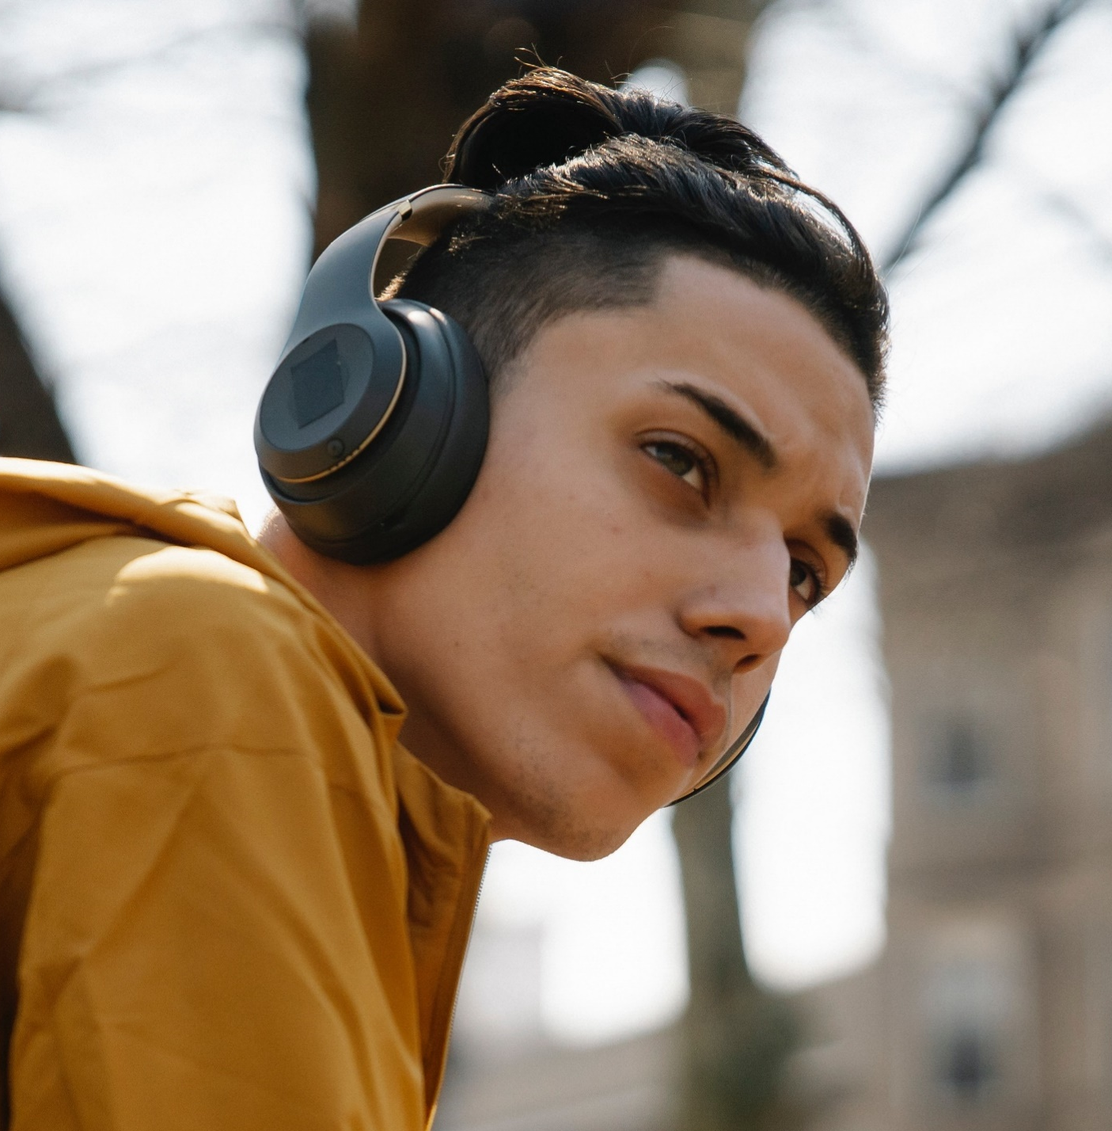
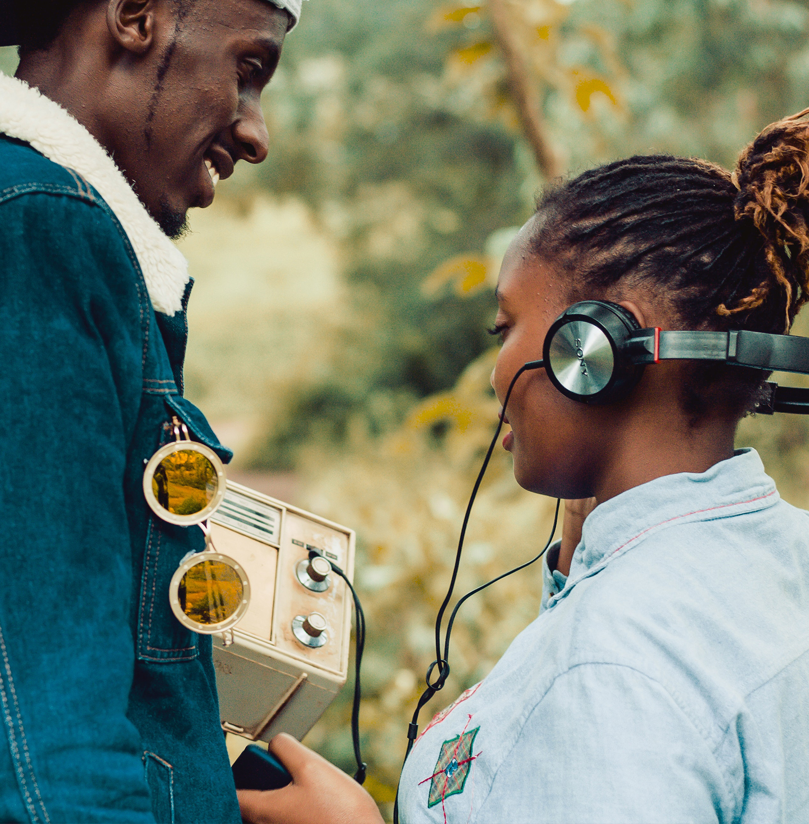

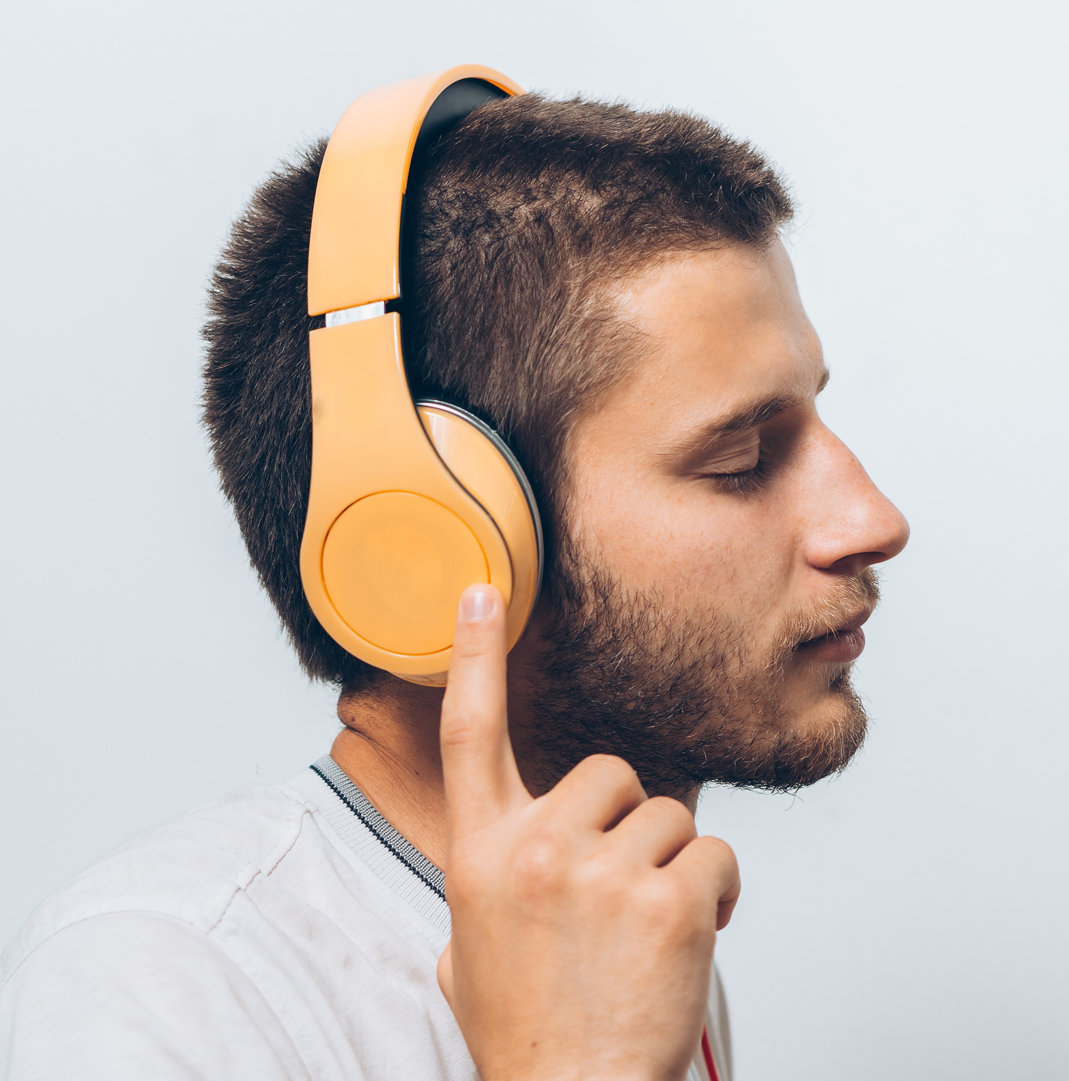





Radio is a massive reach medium for
all age cohorts, including the younger demographics
Gen Z is a uniquely audio-first generation
Weekly, radio reaches 74% of 15-34 yo South Africans and 81% of 12-34 yo Belgians
With 60% of weekly reach and 56% share of total commercial audio listening, radio remains the audio medium to reach the 15-34’s
Audio is becoming more important to a wide range of people. Listening is becoming a sought-after experience
71% of New Zealanders aged
10-34 listen to commercial radio each week
Everyday, 65% of
14-29 yo listen to radio for an average of 182 minutes
2/3 of the 15-24 tune in to radio every day for an average of 3 hours
Sources: New Zealand: GfK Commercial RAM, 2022, Total NZ, Cume %, AP10-34, M-S 12mn-12mn // South Africa: D22Q9 - BRC RAMS November 2021 - October 2022 // Belgium: CIM RAM, RAM 2022/05-08, 05-00h // Germany: ma 2022 Audio II, daily reach mo-fr 14-29 yo // UK: RajarMidas // Ireland: JNLR 2022-2 Audio Module
www.worldradioalliance.com

Slide 12

4
Radio is listened to all day, not just during breakfast and drive time
www.worldradioalliance.com

Slide 13




Radio is everywhere and
it is the most mobile medium
Radio is a hands-free,
eyes-free medium that accompanies listeners in unique moments throughout the day
With additional touchpoints brought by digital audio radio becomes even more ubiquitous
74%
of listeners consume audio during their
daily rituals,
when ears and minds are open, attentive and most perceptive to brand messaging
Source: Audacy Rituals Survey conducted by Alter Agents, July 2022 - US
www.worldradioalliance.com

Slide 14

Radio reaches listeners at key purchase-relevant touchpoints during the day
Radio is the most consumed medium on the way to the shops and the closest to the moment of purchase
Sources: GFK , VAR, radio prior to shopping study (BE)
www.worldradioalliance.com

Slide 15
Radio reaches listeners at key purchase-relevant touchpoints during the day
Radio advertising that reaches shoppers before shopping has a significant effect on purchase consideration for FMCG brands
Radio advertising that reaches shoppers in-car increases brand visibility on-shelf by
+11.3%
With radio ads, purchase intent increases by
+33.1%
across all buyers
Sources: Building Shelf Awareness study – Radiocentre UK
www.worldradioalliance.com

Slide 16

5
Radio is the
#1 medium in connected cars, exactly as consumers want
www.worldradioalliance.com

Slide 17
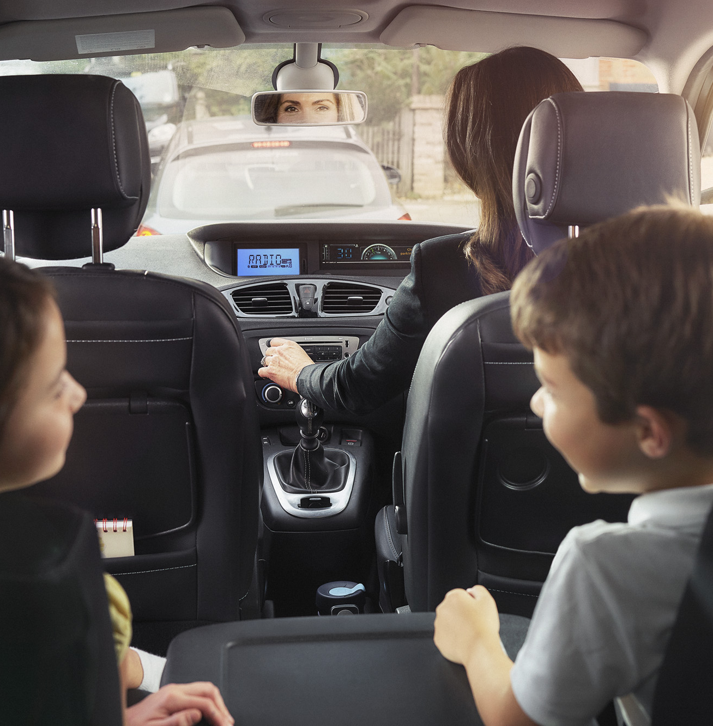



Radio dominates the in-car audio experience
Consumers’ preference for curated in-car audio experience combined with radio integrations on mobile, on dashboard and via applications secure radio’s place in the connected car
Over 80% of consumers are less likely to buy or lease cars without a built-in radio tuner
Radio represents 59% of total audio listening time in the car*
89% of car buyers say broadcast radio should be standard in every vehicle
Consumption of broadcast radio is significantly higher than for any other form of in-car audio; 93% want access to radio to remain free
Sources: Edison research – WorldDAB study 2022 // *Edison Research, Share of Ear Q3 2022
www.worldradioalliance.com

Slide 18

6
Radio must be a part of any optimal media plan
www.worldradioalliance.com

Slide 19
Radio has a multiplier effect and amplifies the efficiency of other channels
Priming with radio increases
television memory encoding.
Advertising on radio prior to television can increase the effectiveness of a television ad**, in particular its moment of peak branding, by up to
+31%
Introducing radio in the media plan increases reach with the same spend*
Sources: *Nielsen Media Impact (2019) // ** In One Ear: radio and memory encoding 2021 (TRB/Neuro-Insight-NZ)
www.worldradioalliance.com

Slide 20


A campaign that includes radio has more impact and is more effective
Top 3 channels for synergies with radio
On average, in the retail sector, adding radio to TV means a 13% gain in the efficiency of the two channels used together vs. their efficiency when played asynchronously
Automotive
FMCG
Telecommunications
Retail
TV
+9%
TV
+8%
TV
+9%
TV
+13%
Search
+8%
Outdoor
+7%
Search
+9%
Press
+6%
Press
+7%
Press
+5%
Press
+5%
Outdoor
+6%
Source: Ekimetrics 2021. Scope: France, 2015-2020, 4 sectors under study Benchmark. The study includes +50 models and ~200 campaigns
www.worldradioalliance.com

Slide 21

7
Radio comes with a truck load of ROI and sales lift evidence to support your choice
www.worldradioalliance.com

Slide 22

Radio is cost effective and generates strong ROI
€7.7
of revenue on average generated per €1 invested
in radio,
in the 4 sectors under study: automotive, telecommunications, FMCG, retail
Sources: (FR) Ekimetrics 2021; (DE) Audioeffekt, ROI Counter
www.worldradioalliance.com

Slide 23

Radio has a multiplier effect and amplifies the
efficiency of other channels
1.3x higher ROI
Radio outperforms total marketing by 128% in terms of retail revenue ROI
Sources: (UK) ROI Multiplier // (Canada) Nielsen Canada CPG Norms Database and Synergy Analysis 2021
www.worldradioalliance.com

Slide 24

8
Radio drives your digital KPIs
www.worldradioalliance.com

Slide 25

Radio reaches more online shoppers than any social media platform
Radio vs digital platform reach
AM/FM
radio
Video
sharing
83%
49%
39%
28%
15%
11%
Source: Numeris RTS Canada Fall 2022 18+ Total Canada; Department/ Warehouse Stores shopped online in past year; Social networks used past 7 days; Total Radio Market Reach 7 day cume. Canadians who have shopped internet department/ warehouse stores in the past year – 7-day reach 18+
www.worldradioalliance.com

Slide 26


Radio drives traffic, search and e-commerce
Radio drives
+29%
lift in
Google search activity¹
+92%
Additional direct
online effect²
Research showed that radio drives up to 92% additional direct effect online
+43%
average brand
web traffic lift thanks to radio³
Radio advertising boosts
brand browsing by
52%⁴
5x
more visits/GRP generated on average by radio campaigns with
clear call-to-action to web/app³
Radio generates
+21%
llllllift in
web activity
for D2C brands⁵
+27.8%
share of website visits delivered with only 10,2% share of advertising on radio⁶
Radio is
4x
more cost effective at stimulating brand browsing than other media⁴
Sources: 1 - Radio Drives Search, RAB, Radio Monitors // 2 - Measuring radio’s ability to drive web conversions – Talpa (NL) // 3 - Radio to Web, Nielsen, TVTY, 2022 // 4 - Radio: The Online Multiplier, Radiocentre UK // 5 – Radio: LeadsRx study of 62 D2C advertisers // 6 Drive2Web from radio campaigns: bynd on behalf of ARD //
www.worldradioalliance.com

Slide 27

9
Radio is so much more than a call-to-action media
www.worldradioalliance.com

Slide 28
Radio drives immediate activation and helps
brands grow
Radio drives immediate activation getting tactical messages to air quickly and building frequency.
Radio also helps brands to grow – the high reach of radio combined with its mood-enhancing effect on listeners brings brand-building messages across.
Radio can improve
the cost-effectiveness of brand campaigns by
over 20%*
Including radio in the mix
significantly increases the
chance of achieving
brand fame
Campaigns which use radio have a stronger “fame effect” than those which do not**
+8%
Sources: * Radio: The Online Multiplier, Radiocentre UK // ** IPA Databank
www.worldradioalliance.com

Slide 29

10
Radio ads are as creative as TV and posters
www.worldradioalliance.com

Slide 30
Radio offers powerful creative and effective
ad solutions for brands
Sound can be a very powerful communicator in a visually crowded media space
Creative testing proves that successful sonic identity brings results for brands
Audio advertising offers creative flexibility and gives each listener a unique experience within the theatre of the mind
Audio creative is critical to driving sales
Creative is the strongest driver for sales effect and
increases sales lift* by almost
50%
Sonic identities
make a significant
difference in purchase intent**
+58%
Sources: * Nielsen Catalina Solutions, nearly 500 CPG campaigns // **WestwoodOne | Veritonic Testing of US-focused radio award winners at Cannes Lion and Clios, Radio Mercury Awards
www.worldradioalliance.com

Slide 31

#bonus
Radio offers a
trusted, safe & sustainable environment
www.worldradioalliance.com

Slide 32
Trust and safety
Radio is a trusted source of information
– even more in time of crisis
Radio offers premium content, ad fraud, and bots-free environment
Most trusted media
 Radio
 TV
 Written press
 Internet
 Country not included in the survey
Source: EBU - Net Trust Index 2022
www.worldradioalliance.com

Slide 33

Trust
Ads heard on radio are the most trusted, reliable and least avoided
Radio ads are
x3
more trusted than
digital ads
Ads heard on AM/FM Radio are the most trusted by A25-54 – nearly 3x the trust granted to digital ads
60%
radio advertising
is reliable
Almost 60% of 18-34 declare radio advertising as reliable
Radio ads are the least likely to be avoided
compared to commercials in any other media environment
Source: Canada: Radio On The Move 2022 & 2021 // Switzerland: Etude d’impact publicitaire 2022
www.worldradioalliance.com

Slide 34
Sustainability
Radio is the most climate-friendly medium as it generates the least amount of CO2
CO2 emissions of ads in different media
34 kg
67 kg
14 kg
4 kg
9 kg
1 kg
Radio ads
for 10 000 contacts
Online display ads
for 10 000 ad impressions
Online video ads
for 10 000 ad impressions
Linear TV ads
for 10000 contacts
Billboard ads
18/1, 10 posters
Newspaper ads
for ½ page,
5 000 circulation
Source: Green GRP - Germany
www.worldradioalliance.com

Slide 35

10 things about radio that may surprise brands
#1
Radio allows brands to reach millions of people on a daily basis
#2
Radio dominates the booming audio landscape
#3
Radio has a huge share of the under 35 age group
#4
Radio is listened to all day, not just during breakfast and drive time
#5
Radio is the number one medium in connected cars, exactly as consumers want
#6
Radio must be a part of any optimal media plan
#7
Radio comes with a truck load of ROI and sales lift evidence to support your choice
#8
Radio drives your digital KPIs
#9
Radio is so much more than a call-to-action media
#10
Radio ads are as creative as TV and posters
#Bonus
Radio offers a trusted, safe and sustainable environment
www.worldradioalliance.com

