Slide 1
www.worldradioalliance.com
February 2024
Radio
builds brands

Slide 2
7 ways
radio builds brands
#1
Trust, engagement and community
Radio stands out as a trusted medium that fosters companionship and connection with listeners
#2
Emotional connection
Radio establishes deep emotional connections with its audience, leaving a lasting impact on brand perception
#3
Attention and memory
Radio drives attention, nurturing brand memory and recall, thereby enhancing overall brand performance
#4
Creativity & theatre of the mind
Radio empowers creative storytelling and ignites listeners’ imagination
#5
Sonic branding
Sonic branding carves a distinctive identity in the auditory landscape, making the brand more memorable in the mind of the listener
#6
Brand integration
Radio's unique capabilities extend beyond traditional 30-second spots, offering opportunities for creative and original brand experiences
#7
Synergy with other media
Radio seamlessly amplifies other advertising channels. A cross-media marketing strategy amplifies brand awareness and recognition
www.worldradioalliance.com

Slide 3
Radio is…
Trust
Attention
Creativity
Synergy
Emotion
Connection
Sonic
www.worldradioalliance.com

Slide 4
1
Trust, engagement and community

Radio stands out as a trusted medium that fosters companionship and connection with listeners
www.worldradioalliance.com

Slide 5
1. Trust, engagement and community
Radio is the most trusted medium
EU net trust Index
NET TRUST INDEX = ‘% of people who tend to trust’ – ‘% of people who tend not to trust’
Average net trust in legacy media (radio, written press, TV) = 8
Average net trust in all media = -9
Average net trust in online media = -34
Note: Survey results at EU level represent a weighted average across the 27 EU Member States, applying official population figures provided by EUROSTAT
Radio
Press
TV
Source: Trust in media – EBU, 2022 (EU)
www.worldradioalliance.com

Slide 6
1. Trust, engagement and community
Radio ads are more trusted and reliable
3x
more trusted than digital ads
Ads heard on AM/FM Radio are the most trusted by A25-54 – nearly 3x the trust granted to digital ads
60%
of radio advertising is reliable
Almost 60% of 18-34 declare radio advertising is reliable
Radio ads are the least likely to be avoided
Source: Radio On The Move, 2022 & 2021 (Canada)
Source: Etude d’impact publicitaire, 2022 – Swiss Radio World AG (Switzerland)
www.worldradioalliance.com

Slide 7
1. Trust, engagement and community
Radio in campaigns increases brand trust
Radio has a very large effect on brand trust
IPA Databank analysis highlights how campaigns that feature radio generate 4x the level of brand trust as those that don’t.
62% uplift
Source: Radio for building brand trust – Radiocentre, 2023 (U.K.)
www.worldradioalliance.com

Slide 8
1. Trust, engagement and community
Radio personalities engage all generations…
The younger the radio listener, the more important radio personalities are as the main reason for listening
Among those who listen to AM/FM radio, % who say this is the main reason they listen “I like particular DJs, shows, or hosts”
Source: Jacobs Media Techsurvey 2023: Personalities are the primary reason for listening to AM/FM radio - Jacobs Media, 2023 (U.S.)
www.worldradioalliance.com

Slide 9
1. Trust, engagement and community
…and connect with listeners
Listeners form meaningful connections with radio personalities
% who strongly or somewhat agree with the statement when thinking about their favourite AM/FM radio DJ personality or show
Source: MARU Matchbox National Study, adults 18+, 2020 (U.S.)
www.worldradioalliance.com

Slide 10
2
Emotional connection

Radio establishes deep emotional connections with its audience, leaving a lasting impact on brand perception
www.worldradioalliance.com

Slide 11
2. Emotional connection
“People think about what they see, but they feel what they hear.”
Source: Sound Creative – Audacy and Veritonic, 2023
www.worldradioalliance.com

Slide 12
2. Emotional connection
Feel-good audio ads change consumer behaviour and deliver long-lasting brand effects
Campaigns that make people feel more positive cause significantly more consumer action change, including brand purchase and use.
* The Star Rating is based on how positively listeners respond to the ad. It predicts the potential of an ad to contribute to long-term brand growth and runs from 1- to 5-Stars. The higher the Star Rating, the more brands should invest in and build campaigns around the ad.
% Claimed consumer behaviour change
Average claimed consumer action change
8.2% more uplift
Source: Listen Up! Report – System1 and Radiocentre, 2023 (U.K.) - System 1 and Radiocentre, 55 campaigns & 44000 UK respondents. Weighted with total campaign media weight (GRPs).
www.worldradioalliance.com

Slide 13
2. Emotional connection
Feel-good audio ads make ad campaigns more famous
Radio campaigns that created more positive emotion see large increases in Word-of-Mouth and Sharing on Social uplifts.
This made the campaign feel bigger than it was, an indication of a fame effect.
* The Star Rating is based on how positively listeners respond to the ad. It predicts the potential of an ad to contribute to long-term brand growth and runs from 1- to 5-Stars. The higher the Star Rating, the more brands should invest in and build campaigns around the ad.
% “Have heared a few times or a lot”, media weighted
% claimed heavy ad exposure
5.3% more uplift in claimed heavy ad exposure
Source: Listen Up! Report – System1 and Radiocentre, 2023 (U.K.) - System 1 and Radiocentre, 55 campaigns & 44000 UK respondents. Weighted with weekly media frequency.
www.worldradioalliance.com

Slide 14
3
Attention & memory

Radio drives attention, nurturing brand memory and recall, thereby enhancing overall brand performance.
www.worldradioalliance.com

Slide 15
3. Attention & memory
Audio ads stimulate high levels of attention
Average attentive seconds per (000) – APM*
*APM (Attentive seconds per 1000 impressions)= Per 1000 billable impressions served, how many seconds of attention to my advertising should I expect to receive.
Source: dentsu Attention Economy Study - Lumen, 2023 (U.S.)
www.worldradioalliance.com

Slide 16
3. Attention & memory
Radio and podcasts ads have the most cost-efficient attention CPM
Attention CPM (aCPM*)
*aCPM= how much does it cost to generate 1000 seconds of attention to advertising.
Source: dentsu Attention Economy Study - Lumen, 2023 (U.S.)
www.worldradioalliance.com

Slide 17
3. Attention & memory
Audio generates greater brand recall
When compared to digital, radio listeners remember more brands and mention them more often
223 BRANDS
785 MENTIONS
3.5 MENTIONS X BRAND
204 BRANDS
354 MENTIONS
1.7 MENTIONS X BRAND
Digital: hyperfragmented memory
Source: The Paradox of Media Planning / Advertising Effectiveness Study – AERC, 2023 (Spain)
www.worldradioalliance.com

Slide 18
3. Attention & memory
Audio is a powerful influencer whether you are paying attention or not. You simply can’t shut your ears!
Percentage of brands correctly recalled
An audio ad playing in the background while respondents were highly distracted still generated 30% recall
An audio ad that is actively being listened to with no distractions will generate a 78% brand recall
Source: Sound Check: Ears Wide Open – Neurolab, 2023 (U.S.)
www.worldradioalliance.com

Slide 19
4
Creativity & theatre of the mind

Radio empowers creative storytelling
and ignites listeners’ imagination
www.worldradioalliance.com

Slide 20
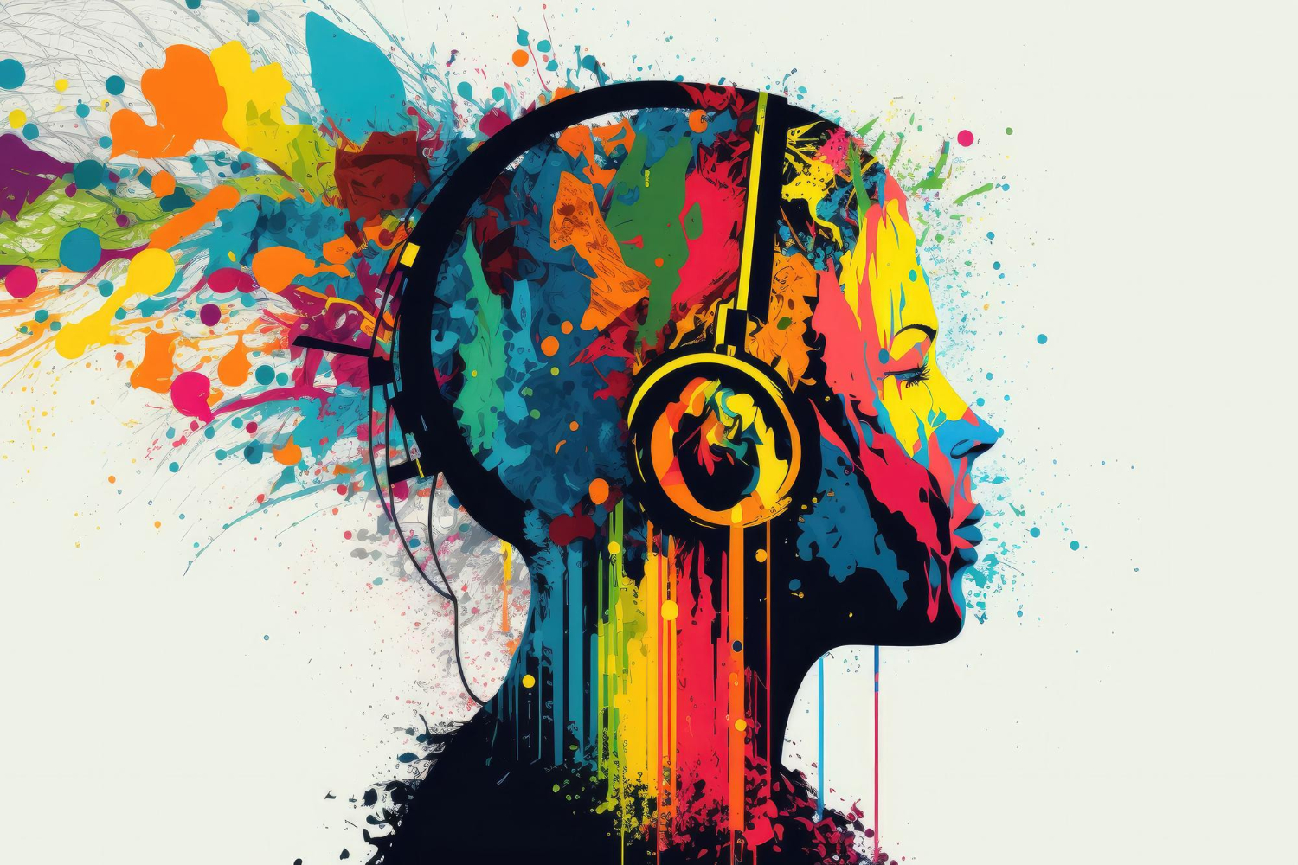
4. Creativity & theatre of the mind
Creative is a key driver of advertising effectiveness in radio
% Contribution to incremental sales (2023)
Source: Five Keys to Advertising Effectiveness – NC Solutions, 2023 (U.S.)
www.worldradioalliance.com

Slide 21
4. Creativity & theatre of the mind
Radio ads with music drive higher results in both recall and purchase
Incorporating music into ads propels:
Ads with multiple voices increase recall by 10%
Intent to purchase by over 5%
Recall by over 4%
Energic emotion by over 3%
Source: Sound Creative – Audacy and Veritonic, 2023 (U.S.)
www.worldradioalliance.com

Slide 22
5
Sonic branding

Sonic branding carves a distinctive identity in the auditory landscape, making the brand more memorable in the mind of the listener
www.worldradioalliance.com

Slide 23
5. Sonic branding
Audio logos drive recall on radio more than ads without
sonic branding
Sonic branding increases ad recall by over 17% in radio and over 14% in podcasts
Radio ads with sonic branding are heard as
+7% more trustworthy
+6% more likeable
+5% more empowering
+4%
more relevant
Source: Sound Creative – Audacy and Veritonic, 2023 (U.S.)
www.worldradioalliance.com

Slide 24
5. Sonic branding
Ads with an acoustic brand signal achieve considerably more positive results on recall, attraction and activation
The importance of acoustic signals
Source: MediaAnalyzer – RMS, 2021 (Germany)
www.worldradioalliance.com

Slide 25
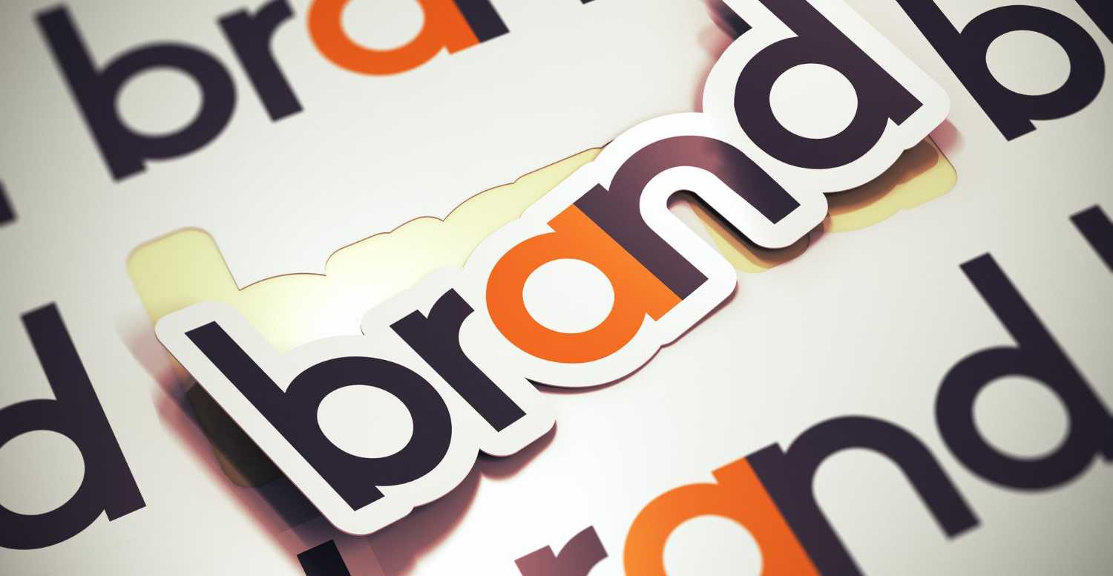
6
Brand integration

Radio's unique capabilities extend beyond traditional 30-second spots, offering opportunities for creative and original brand experiences
www.worldradioalliance.com

Slide 26
6. Brand integration
Contests/ games
Engagement with listeners on radio stations’ social media
DJ/host endorsement
Events/ concerts
Editorial content/ segments
Sponsorship
www.worldradioalliance.com

Slide 27
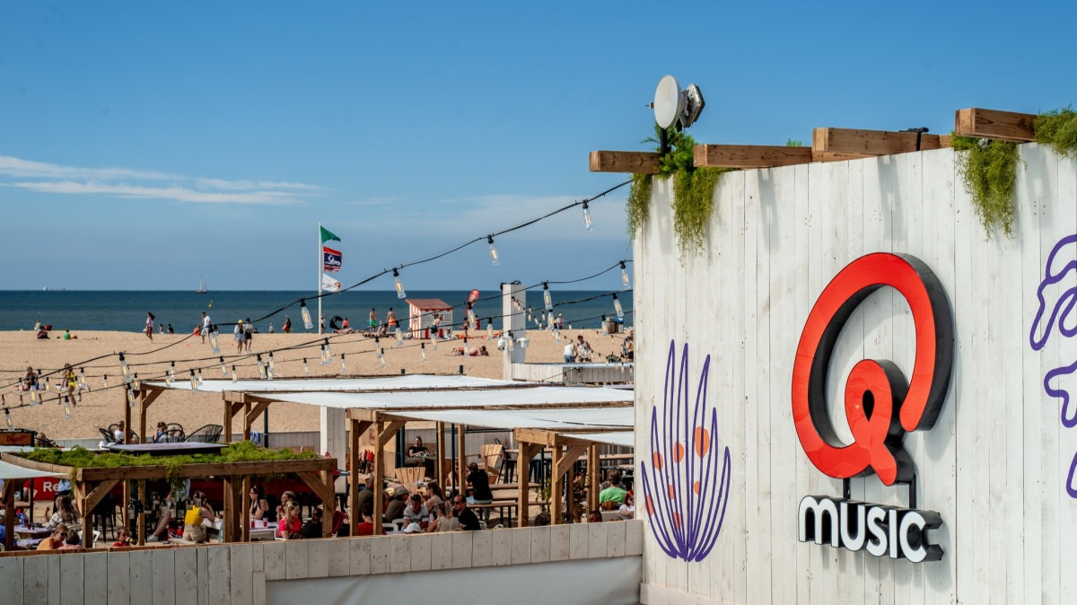
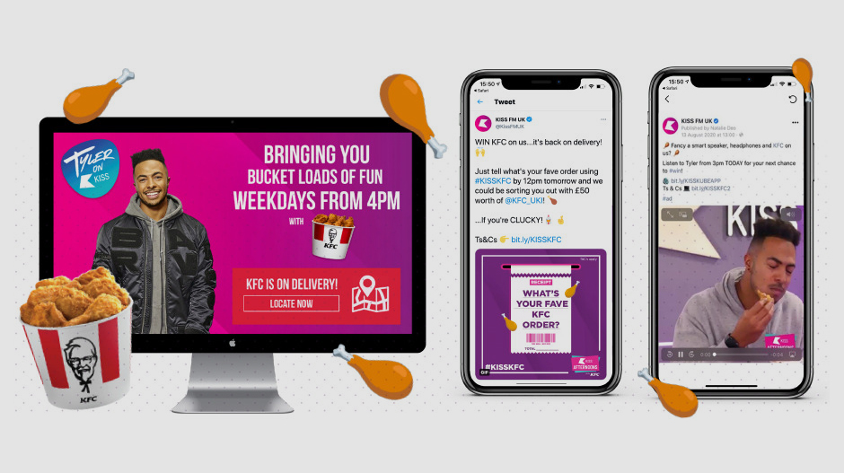
6. Brand integration
Inspiring business cases
NRJ Hybrid challenge
Driven by NRJ presenters, new Toyota Cross Hybrid travelled across France, in ‘zero emission’ mode, whenever possible, to meet listeners and local presenters from NRJ stations.
More details here
Q-Beach House – where music fans and brands come together for an unforgettable summer
The Flemish radio station, Qmusic, brought together thousands of listeners at a unique beach venue, helping brands shine through cross-platform integration.
More details here
KISS, KFC and a bucket of fun!
A brilliant long-term collaboration between KFC and Bauer Media Audio UK. As the headline sponsor of a popular afternoon show, KFC was at the forefront of their customers’ mind, especially for those looking to get their fix of fiery chicken fun.
More details here
www.worldradioalliance.com

Slide 28
7
Synergy with other media

Radio seamlessly amplifies other advertising channels. A cross-media marketing strategy amplifies brand awareness and recognition.
www.worldradioalliance.com

Slide 29
7. Synergy with other media
Adding radio to a campaign improves efficiency, making radio THE multiplier medium
Ad awareness:
radio generates
5x
more
cost-efficiency
Brand relevance:
radio generates
3x
more
cost-efficiency
Brand trust:
radio generates
4x
more
cost-efficiency
Source: Building Shelf Awareness – Radiocentre (U.K.)
www.worldradioalliance.com

Slide 30
7. Synergy with other media
Adding radio to TV and online video increases the brand attitude and preference
The combination of online videos and radio results in a significant increase with index 111 on attitude towards Douwe Egberts.
Furthermore, the usage of TV and radio in combination results in an increase of 138 point index in terms of preference for the Douwe Egberts brand.
 | TV only | TV + OLV | Radio + TV | Radio + OLV
Attitude | 100 | 99 | 100 | 111 
Preference | 100 | 110 | 138  | 114
❐ Significant increase compared to premeasurement (95% confidence)
Source: How does radio contribute to the mental availability of FMCG brand Douwe Egberts? – Audify, 2023 (The Netherlands)
www.worldradioalliance.com

Slide 31
7. Synergy with other media
Radio combined with TV generates more attention and increases the effectiveness of the ad
1.5x
More attention
Advertising on radio prior to television can increase the effectiveness of a television ad, in particular its moment of peak branding, by up to
+31%
Source: The Magic of Attention – Ster, 2022 (The Netherlands)
Source: In One Ear: radio and memory encoding - TRB/Neuro-Insight, 2021 (New Zeeland)
www.worldradioalliance.com

Slide 32
7. Synergy with other media
Visual transfer drives impact for the brand
Index 156
Increase of
MAGNUM RUBY
awareness
Taking advantage of the visual transfer power of radio, Unilever added radio to its TV plan and significantly increased the brand awareness (and the purchase intent) for the new MAGNUM RUBY.
Source: Brand Effekt – Kantar/RMS, 2023 (Germany)
www.worldradioalliance.com

Slide 33
7. Synergy with other media
Radio enhances OOH messaging
A prior exposure to a radio campaign increases how quickly outdoor media is seen and how well it is remembered
Eye tracking (time to first fixate on panel elements – seconds)
+22% faster
+26% faster
+45% faster
Source: ARN Research – Neurolab, 2023 (U.S.)
www.worldradioalliance.com

Slide 34
7. Synergy with other media
When combined with online audio, radio increases ad recall
40% higher ad recall
Radio
Online audio
Source: RMS Audio Total Tracker Data – RMS, 2021 (Germany)
www.worldradioalliance.com

Slide 35
Reach out to your media partners and start building your brand today!
www.worldradioalliance.com

