Slide 1

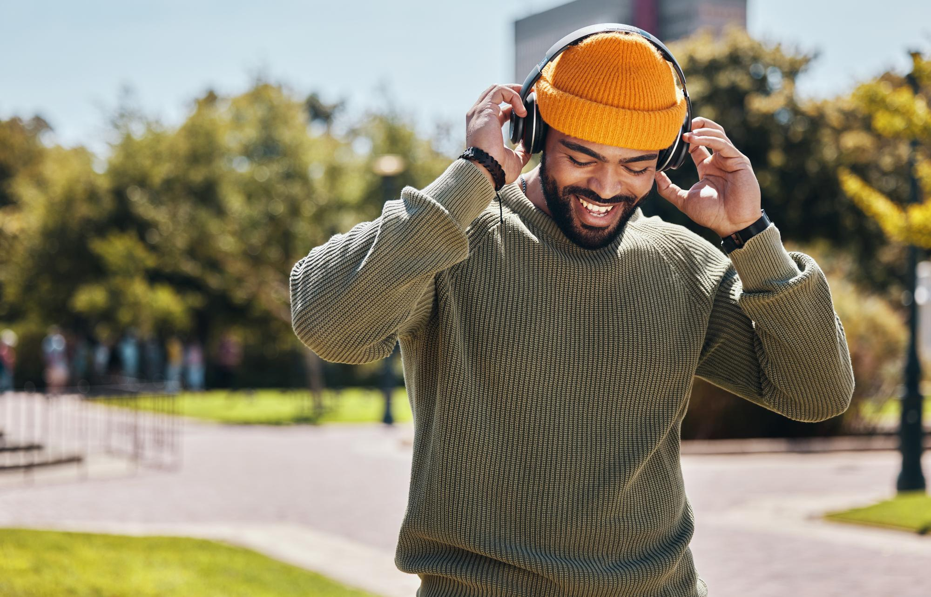
www.worldradioalliance.com
February 2025
Radio,
the Audio Leader
Compiled by

Slide 2


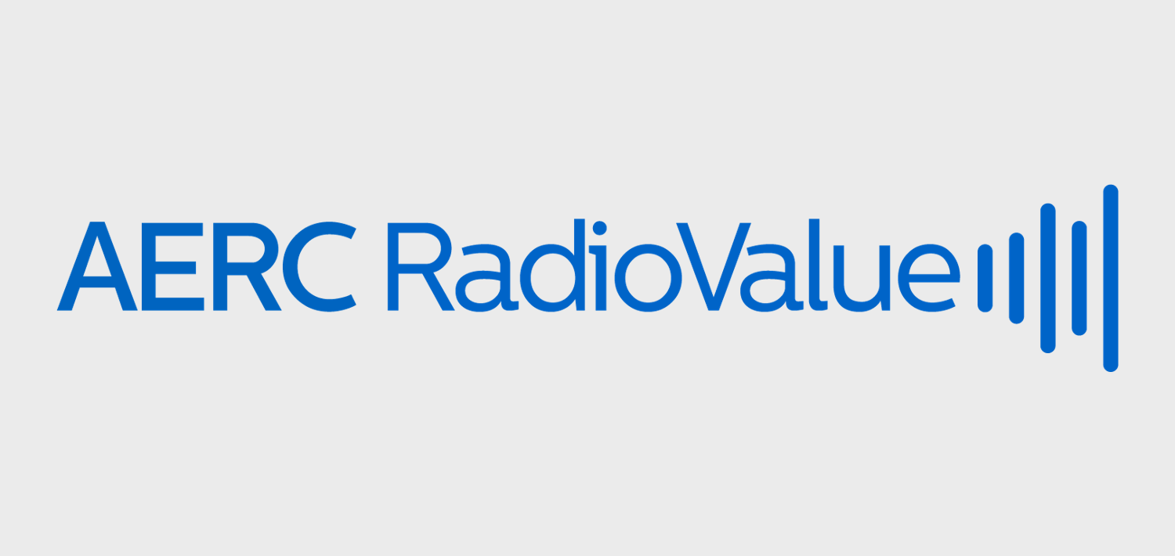
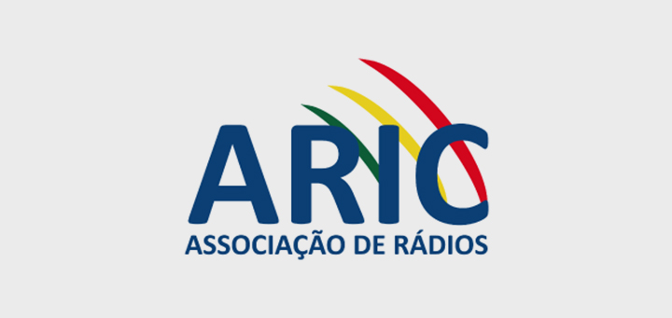
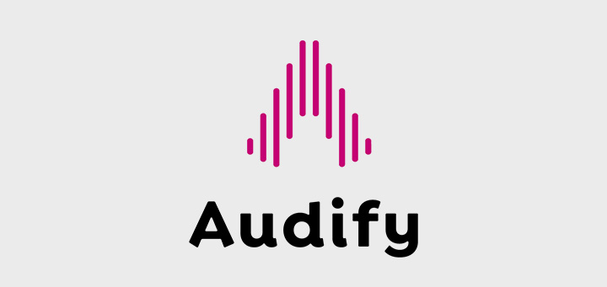
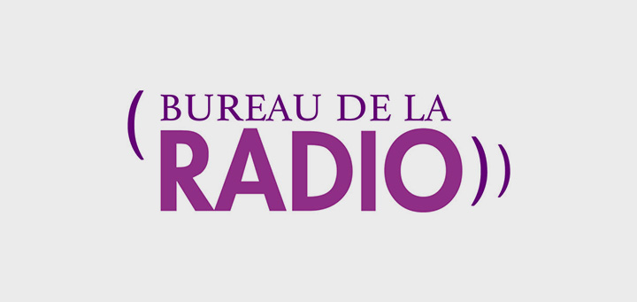
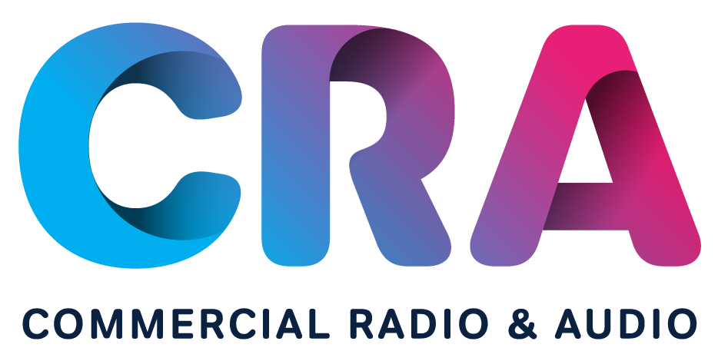
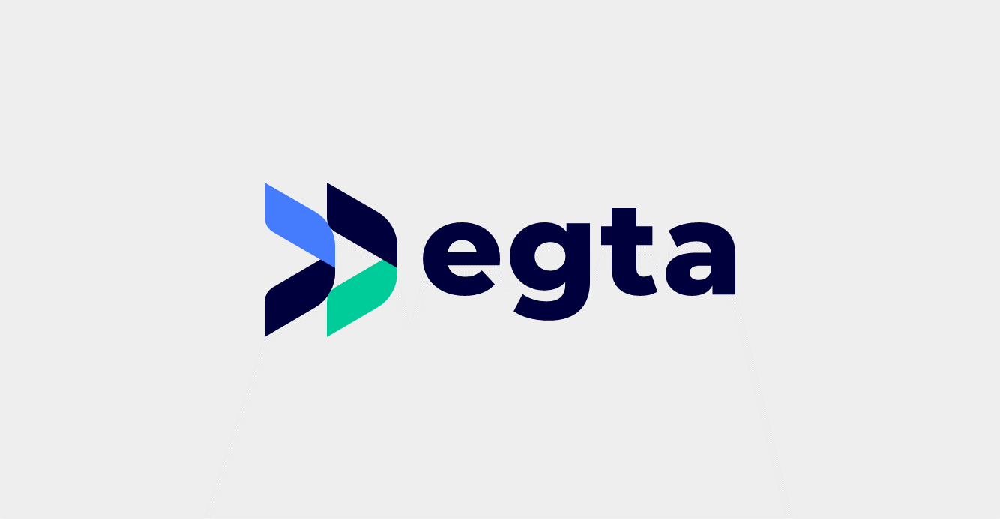

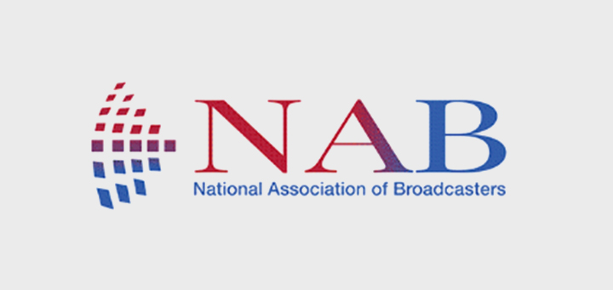
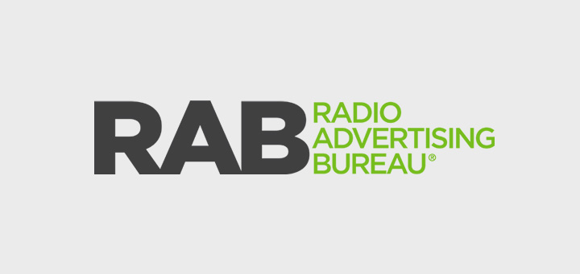
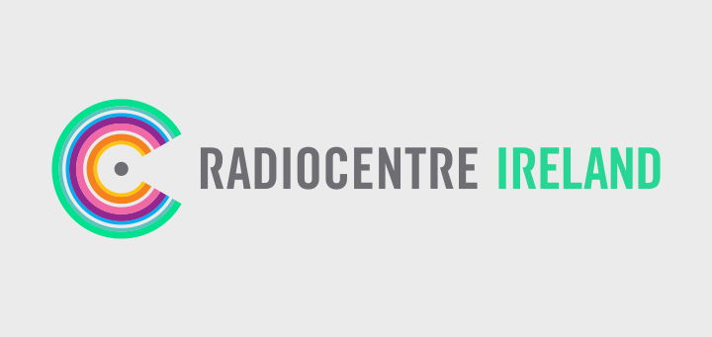

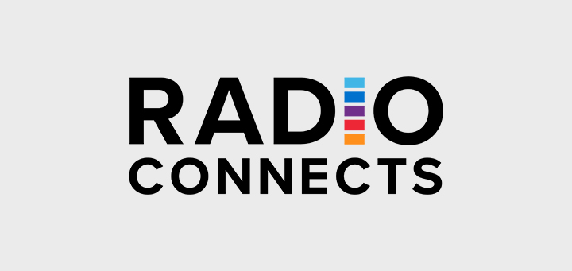
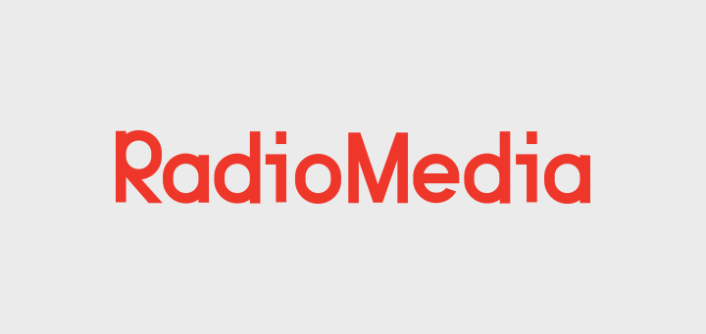

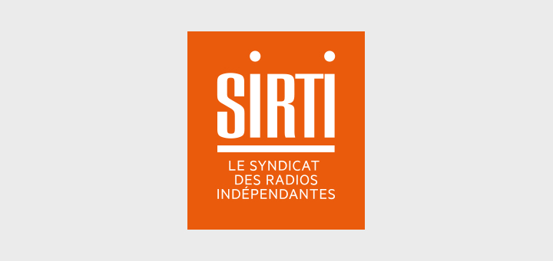
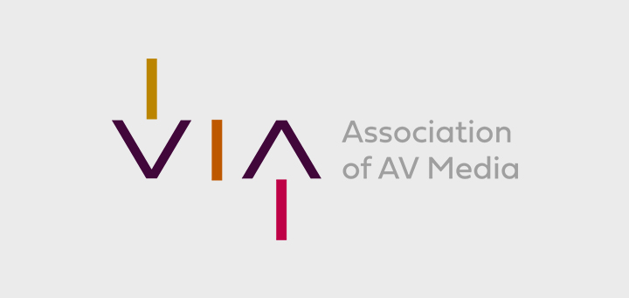

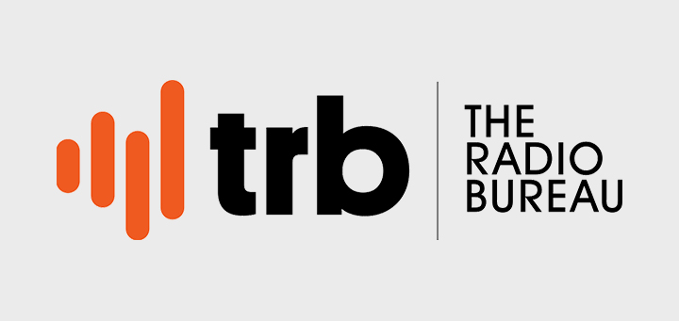
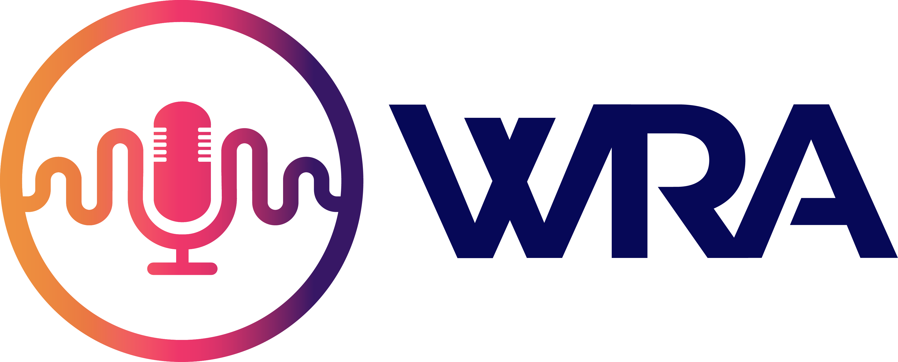
Radio, the audio leader
About WRA
We, the World Radio Alliance,
want to demonstrate to advertisers and agencies that radio is the leader in audio within an evolving media landscape, offering brands a unique opportunity to deliver impactful messages.
www.worldradioalliance.com
About WRA
WRA is a worldwide grouping of broadcasters and sales houses’
trade bodies from 16 markets,
across 4 continents,
whose joint objective is to promote and demonstrate the power and value of radio and audio in the media landscape.
www.worldradioalliance.com

Slide 3
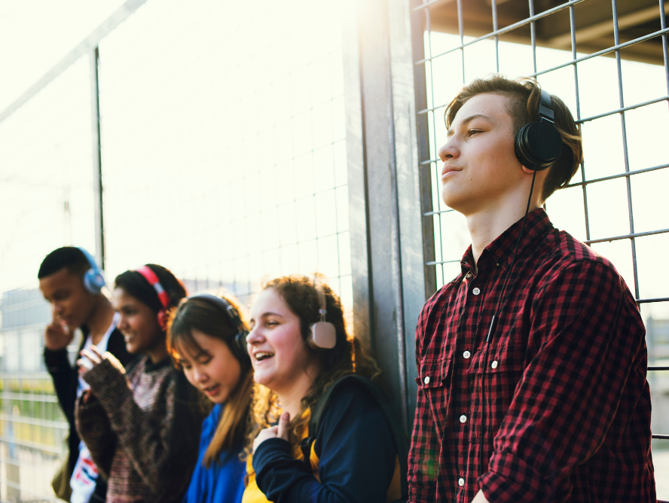
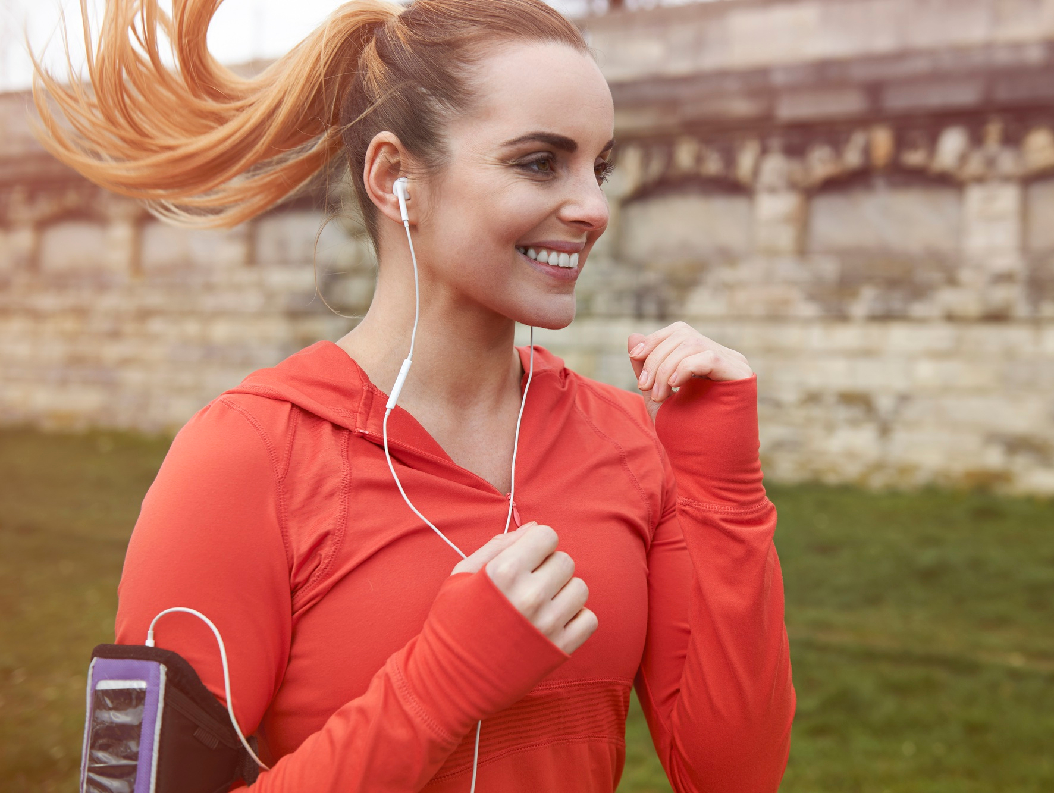





Radio: the Audio Leader
Highest
audio consumption and
ad-supported listening
Most trusted
Unmatched reach
Most mobile
www.worldradioalliance.com

Slide 4
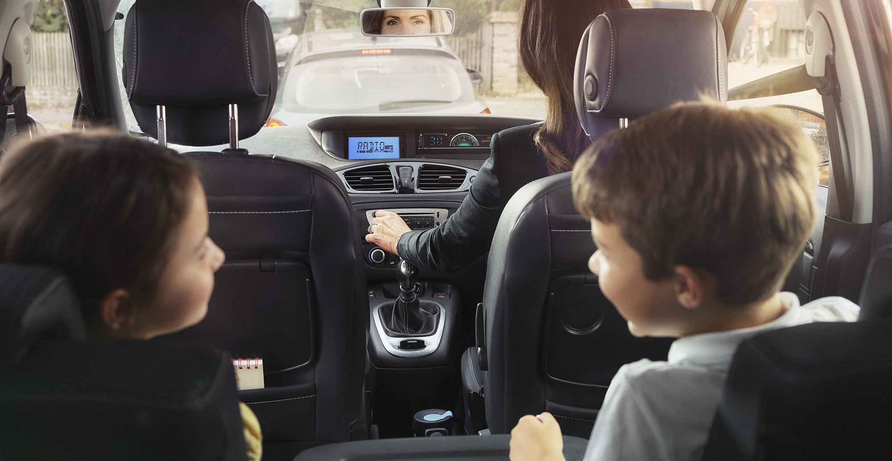
1
Radio dominates the audio consumption

Radio has the highest share of listening time and is the biggest part of the ad-supported audio landscape
www.worldradioalliance.com

Slide 5










1. Radio has the highest share of listening time
Daily share of audio listening time
○ Broadcast radio LIVE
(FM / AM / DAB / online radio via app or site / on TV)
○ Owned music (CDs, digital file
○ Music streaming / Music on demand (e.g. Spotify)
○ Podcasts
○ Online music video (e.g. YouTube)
○ Other
Source: IE: Ipsos JNLR 2024 2 Audio Module (April 24 – June ’24), pop. 15+ | AU: GFK Share of Audio 2022, Metro, pop. 10+ I BE: CIM Audio Time 2025, pop. 12+ | NL: NMO December 2024, pop. 13+ | DE: Medienstudie 2024, pop 14+ | UK: Rajar Midas 2024 | FI: National Radio Survey, Finnpanel, Jan-Nov 2024, population 9+ | FR: Mediametrie Global Audio 2024, pop. 15-80 y.o. ​| US: Edison Share of Ear 2024, pop. 13+ |
www.worldradioalliance.com
Notes:
Increased size of radio figures
Added radio icon

Slide 6
1. Live radio is the biggest part of the ad-supported audio landscape
Radio is the only medium that offers scale for brands to reach their consumers within the audio landscape
Daily share of time spent with RADIO within total audio listening
88%
88%
87%
65%
70%
78%
Daily share of time spent with LIVE RADIO within ad-supported audio listening
○ Broadcast radio LIVE (FM / AM / DAB / online radio via app or site / on TV)  Music streaming / Music on demand (e.g. Spotify)  Podcasts  Other
Source: IE: Ipsos JNLR 2024 2 Audio Module (April 24 – June ’24), pop. 15+ | BE: CIM Audio Time 2024, pop. 12+ I NL: NMO December 2024, pop. 13+ | FR: Mediametrie Global Audio 2024, pop. 15-80 y.o.​ | US: Edison Share of Ear 2024 | AU: GFK Share of Audio 2022, Metro, pop. 10+
www.worldradioalliance.com
Notes:
Angles changed (TM) + colors total

Slide 7
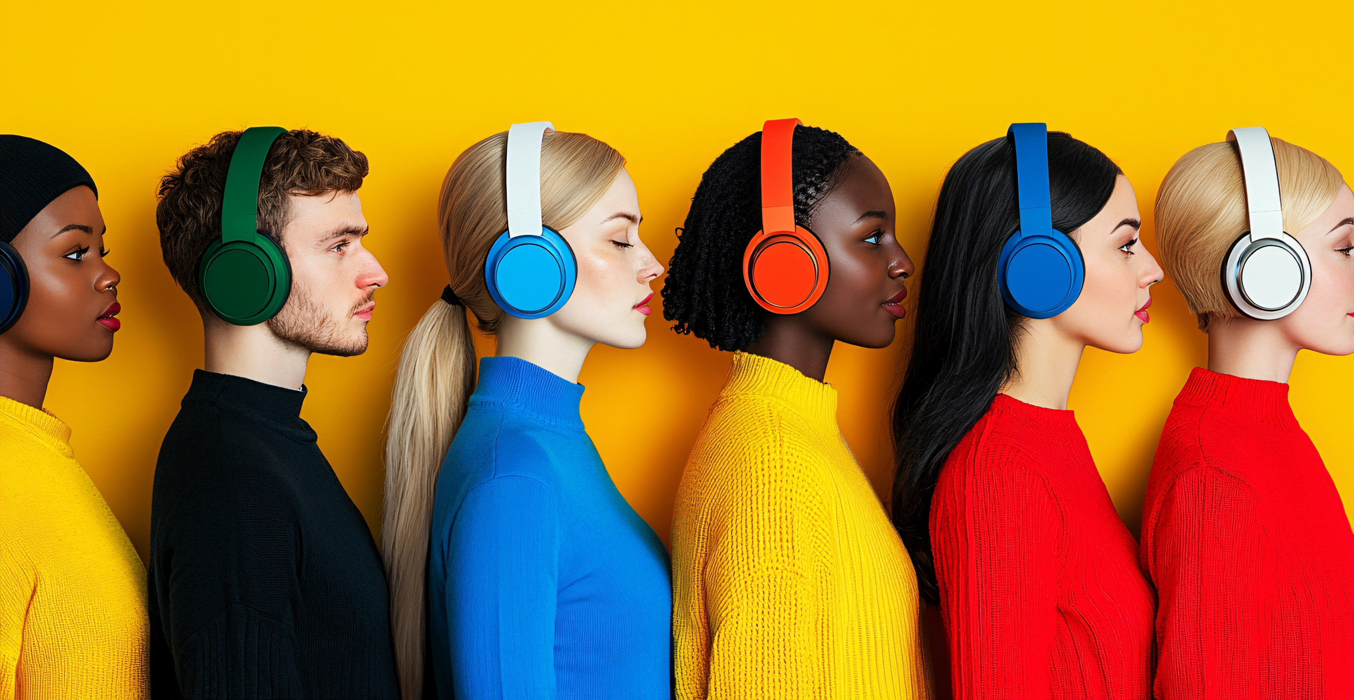
2
Radio has an unmatched reach

Radio offers brands a powerful platform to connect with large audiences, making it an essential tool for maximising visibility and impact
www.worldradioalliance.com

Slide 8






2. Radio has an incomparable reach across the world
Radio is the only medium that offers scale for brands to reach their consumers within the audio landscape
% of population listening to radio every week
78%
88%
90%
84%
90%
84%
86%
64%
83%
84%
80%
82%
74%
81%
74%
Source: DE: ARD/ZDF-Medienstudie 2024, pop. 14+ | UK: RajarMidas 2024 | IE: Ipsos JNLR 2024 2 Audio Module April 24 – June ’24, pop. 15+ | NL: NMO December 2024, pop. 13+ | IT: ER (Tavolo Editori Riuniti), total 2024, pop. 14+ | FR: EAR Insights, Sept-Oct24, pop. 13+ | BE : CIM RAM sept23-aug24, pop. 13+ | ES: EGM 3rd wave 2024 | PT: Marktest Bareme Radio, Jan-Dec 2024, pop. 15+ | FI: National Radio Survey, Finnpanel, Jan-Nov 2024, pop. 9+ | US: Nielsen Radar 162 2024, pop. 12+ | CA: Numeris PPM Total Meter CTRL, Fall 2024, pop. 18+ | ZA: BRC RAM data for Jan 22 - Dec 23, pop. 15+ | AU: The Infinite Dial 2024, total pop. 12+ | NZ: The Infinite Dial 2023, total pop. 16+
www.worldradioalliance.com
Notes:
TM relanced: DE
Changed the colors (black to off-white)

Slide 9
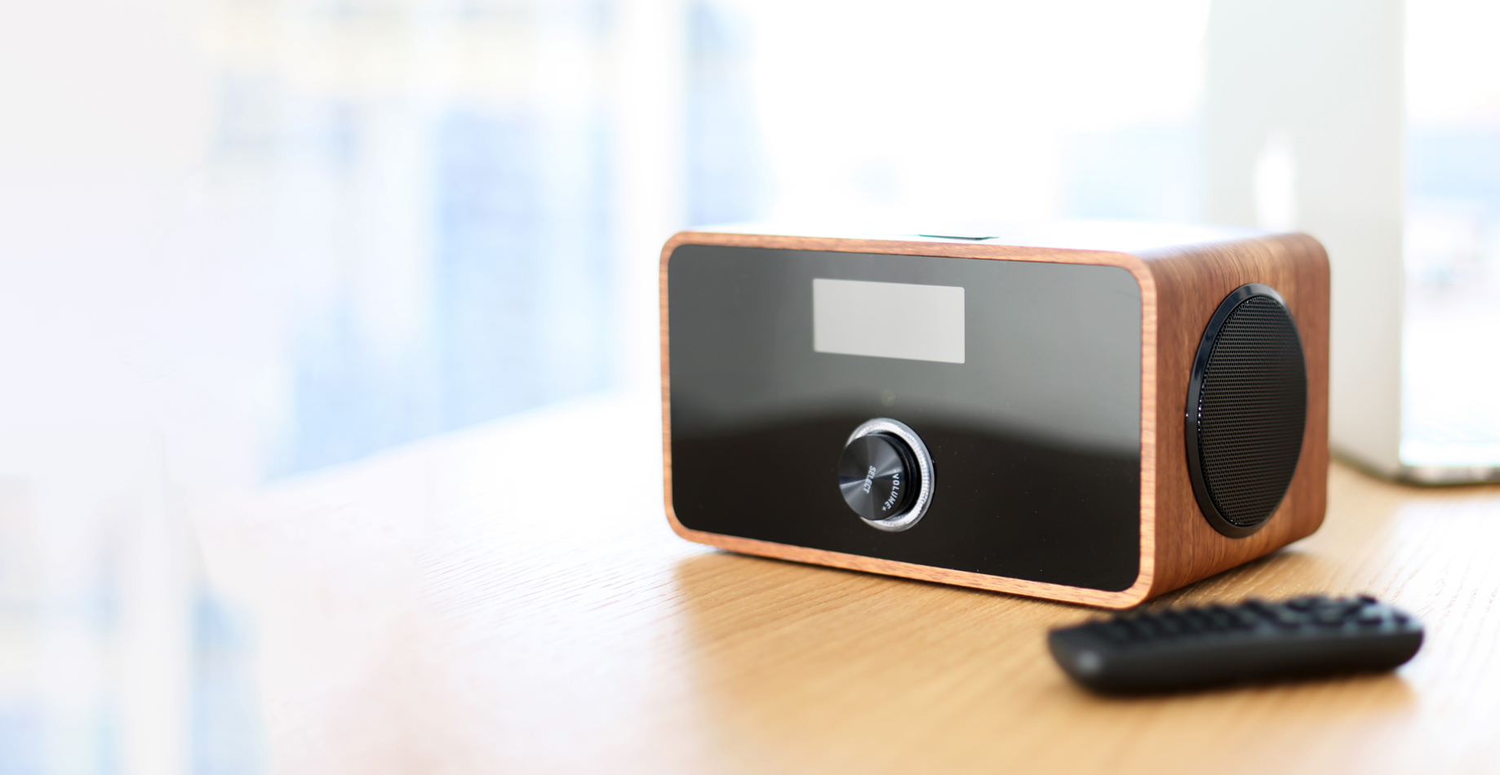
3
Radio is the most trusted and reliable medium

Radio stands out as a trusted medium that fosters companionship and connection with listeners
www.worldradioalliance.com

Slide 10
3. Radio is the most trusted medium
Radio offers premium content in a trusted and safe environment
% of population who tend to trust by type of media
Source: European Commision – Standard Eurobarometer 102 - Oct-Nov 2024 - population 15+
www.worldradioalliance.com
Notes:
Added radio icon

Slide 11
3. Radio ads are the most trusted form of advertising
This trust translates into higher engagement rates, making radio an essential medium for advertisers looking to build lasting consumer relationships
Where people expect to be exposed to trustworthy ads
Ads heard on AM/FM Radio are perceived as more trustworthy by Canadians compared to ads experienced on other platforms. Trust is a vital factor for effective advertising.
Source: Canada: Signal Hill Insights | Maru Voice Canada, September 2024 survey of 3,000 Canadians 18+.
www.worldradioalliance.com
Notes:
RADIO ADVERTISING CONTINUES TO
RANK AS ONE OF THE MOST TRUSTED
FORMS OF ADVERTISING

Slide 12
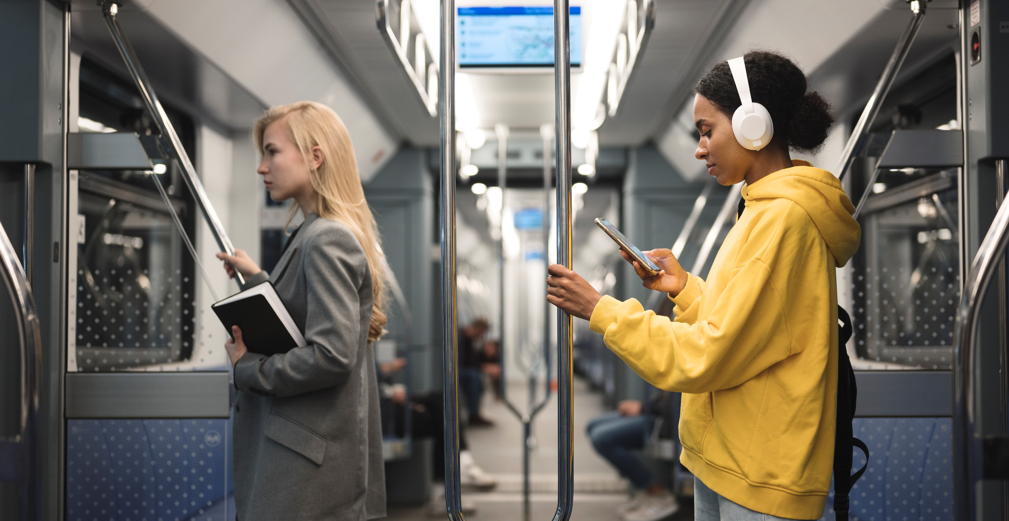
4
Radio is the most mobile mass medium

Radio is the ultimate mobile medium: accessible everywhere, hands-free, eyes-free, on any device, seamlessly accompanying listeners throughout the day
www.worldradioalliance.com

Slide 13
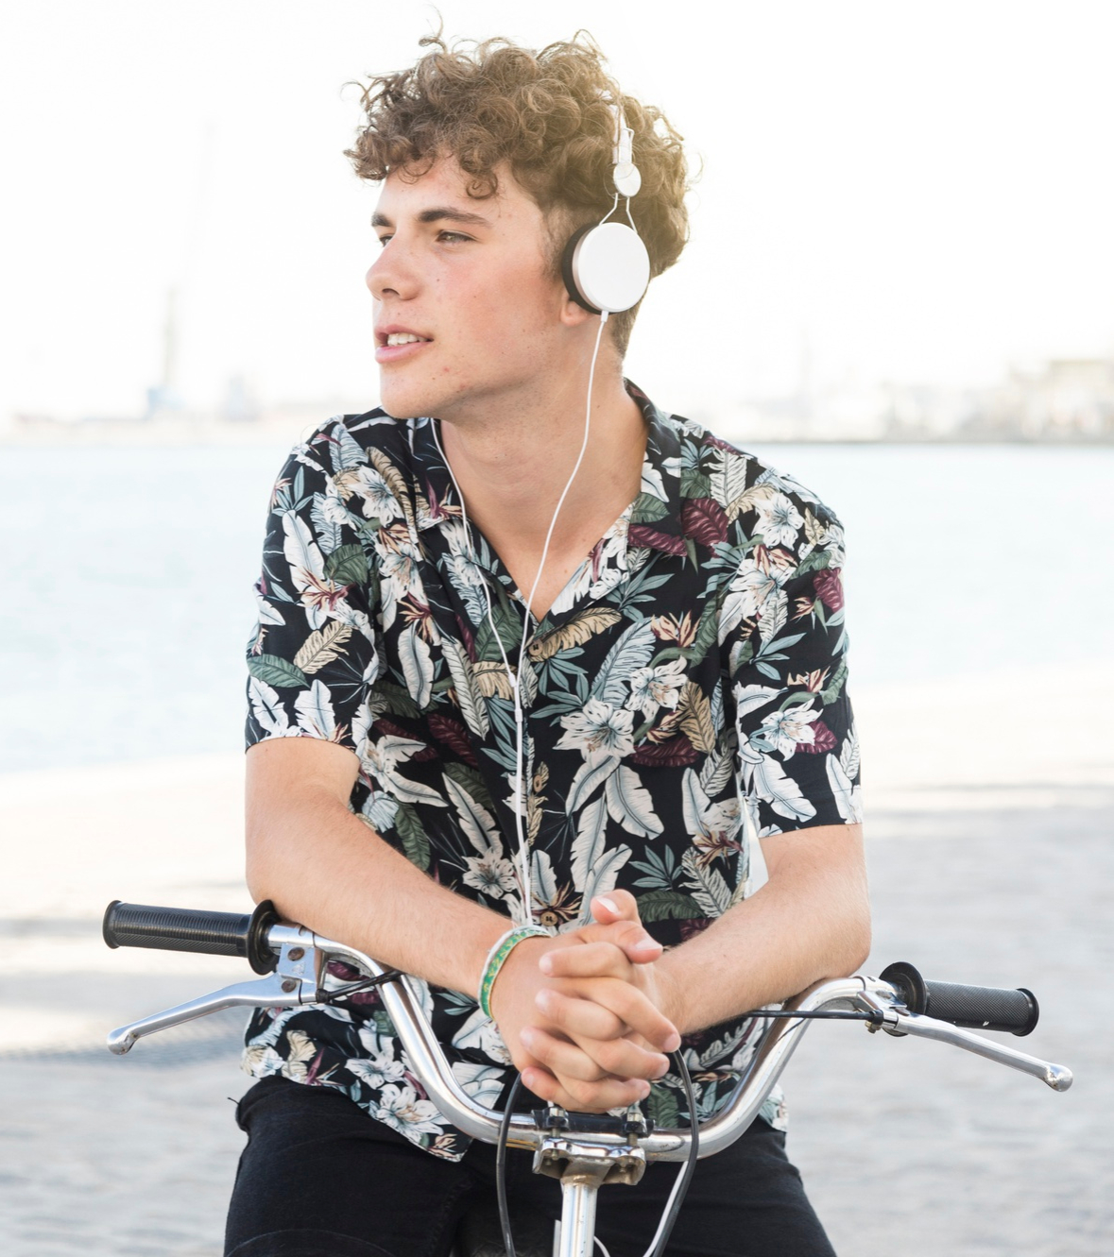
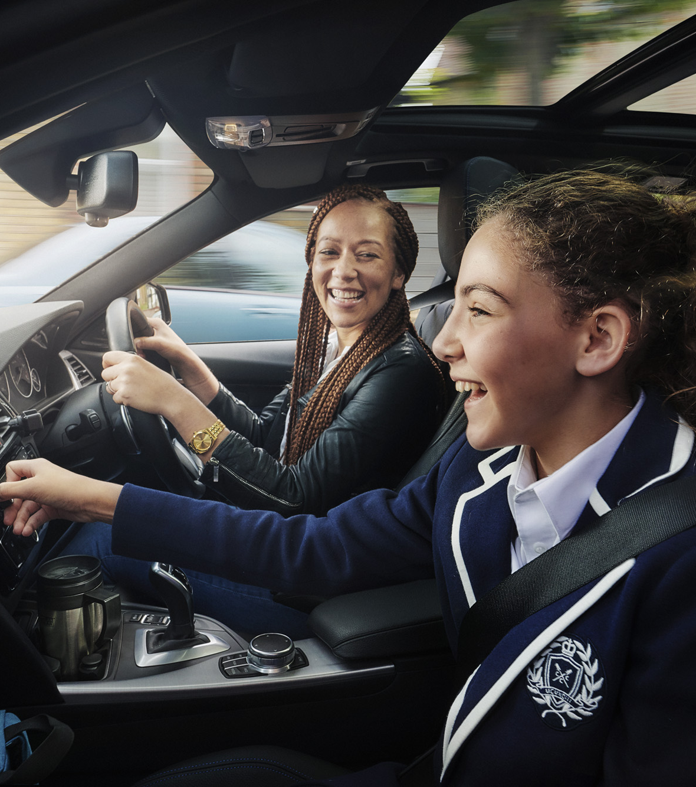
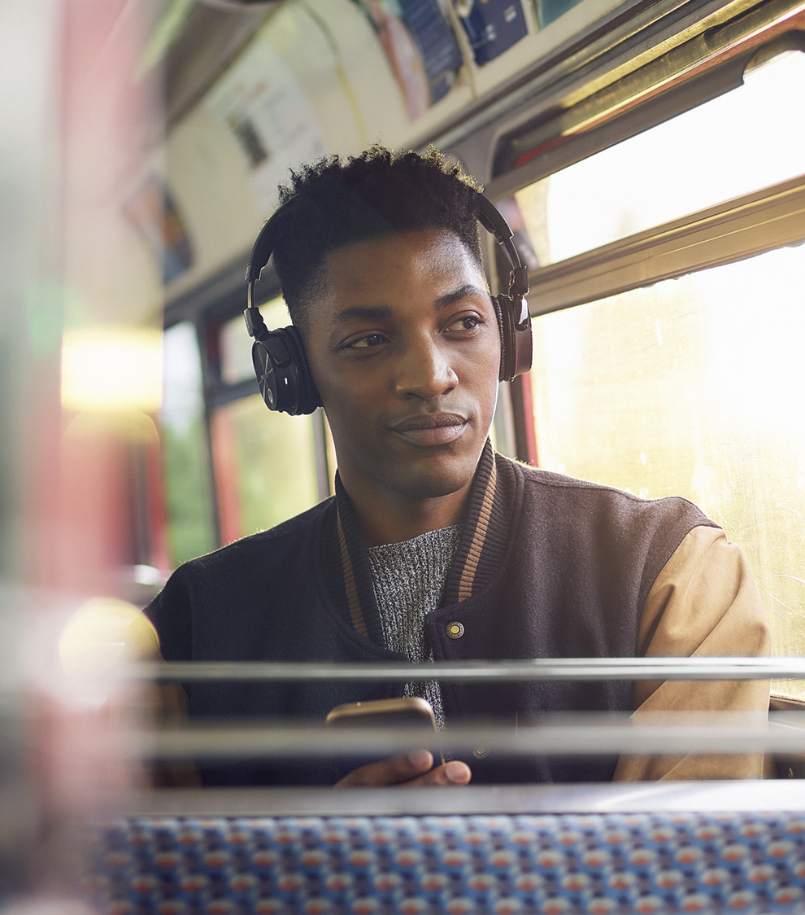
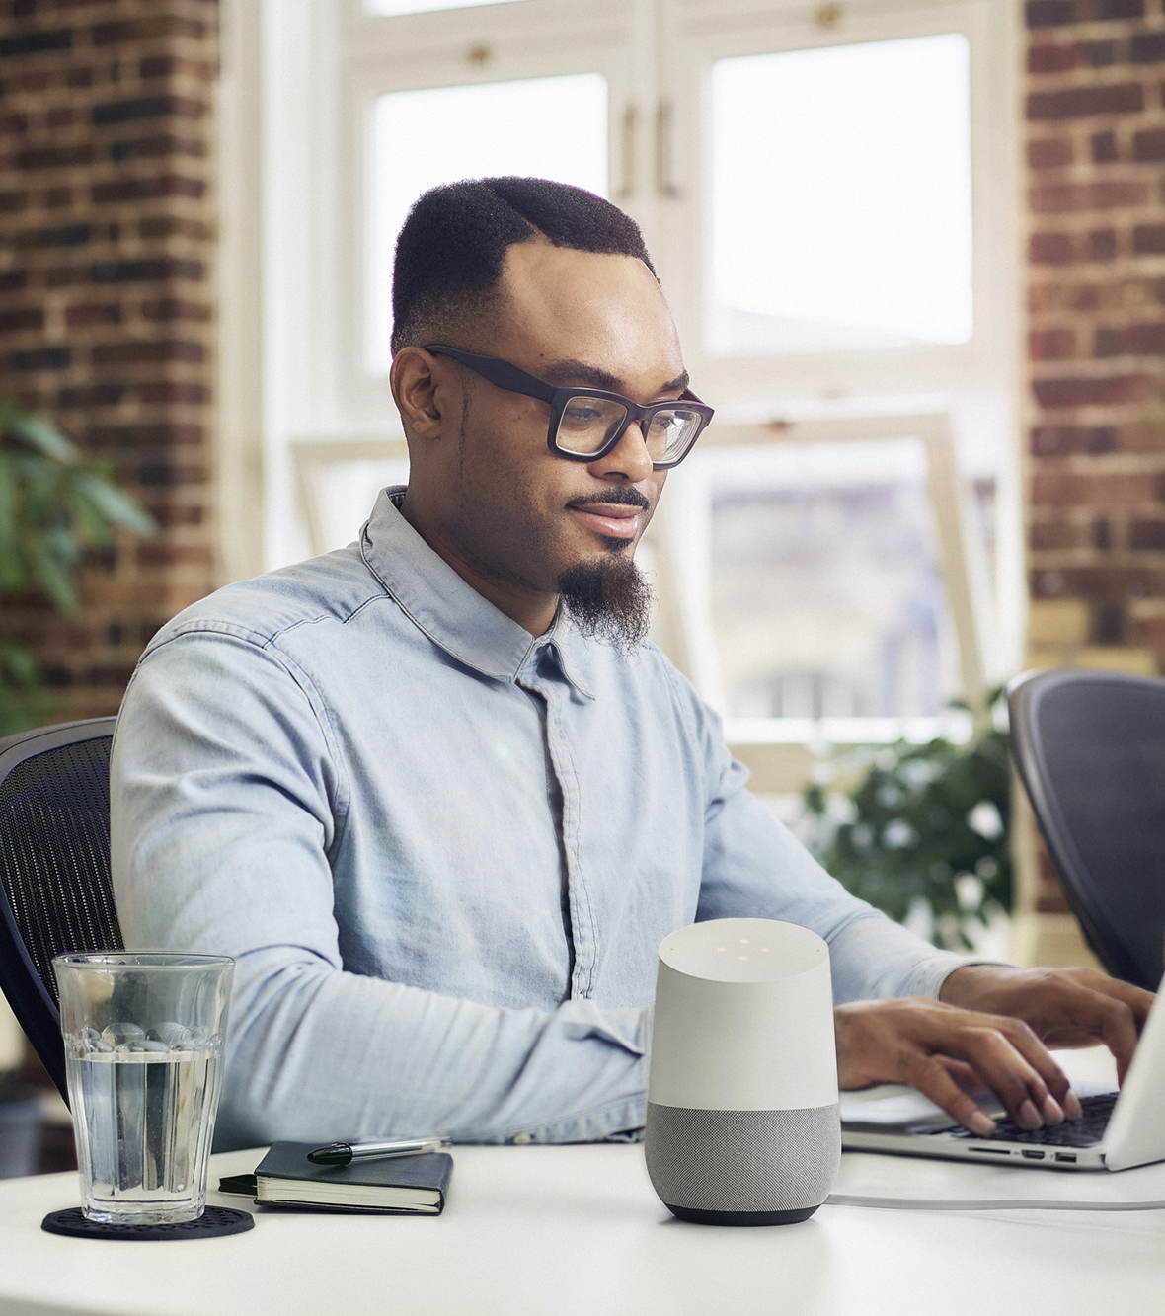

Radio is everywhere and more than ever
the most mobile mass medium
Multiple
devices
Multiplatform
Live
and
on-demand
Hands-free
and
eyes-free
Accompanies listeners throughout
the day
On-the-go
www.worldradioalliance.com

Slide 14
1. XXX
Radio, the Audio Leader
Radio is the leader of audio, connecting communities worldwide.
Even as audiences embrace new platforms, radio stands out with unmatched reach, time spent, trust, and engagement, offering brands a unique opportunity to deliver impactful messages and achieve results in a fragmented media landscape.
www.worldradioalliance.com

